Slide 1
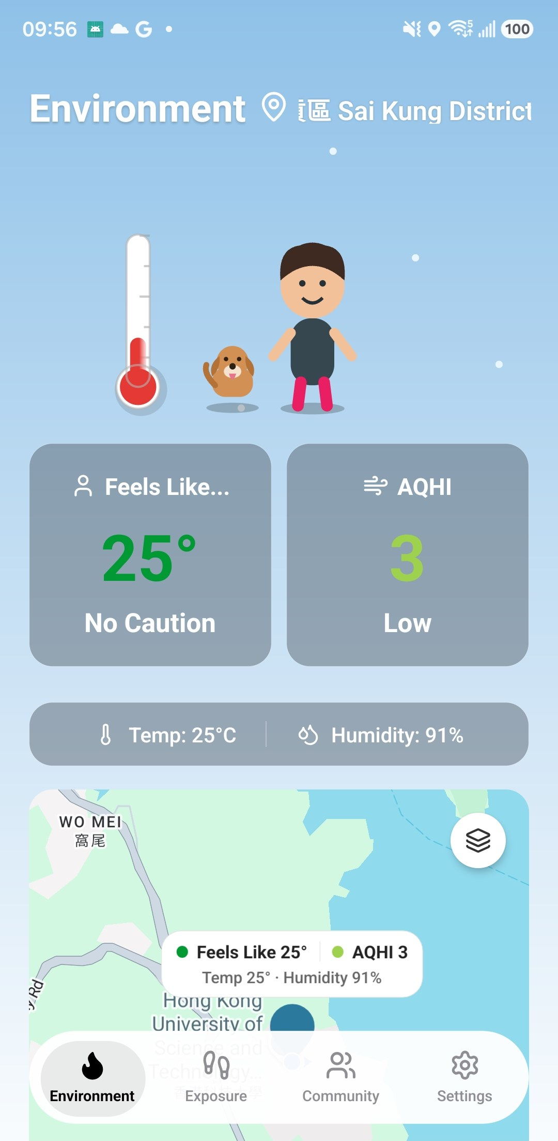
Heat Alert App
Heat, air quality and your personal exposure, in one app for Hong Kong
Environment
Exposure
Community
Alerts
Notes:
Opening. One-line pitch: the app shows live heat index and AQHI, tracks where you spend your day to estimate personal exposure, and sends alerts tuned to who is at each place.
Built with React Native 0.86 (Android shown).

Slide 2




Four modules — pick what to show
Each module stands alone. Click a card to jump; delete or hide any section.
Module A
Module B
Module C
Module D
Environment
Exposure
Community places
Alerts & settings
Live heat index & air quality, forecast, map layers
Track or import your day, see personal exposure
Save places, set who is there
Event-based alerts that fit the person
Slide 3 →
Slide 8 →
Slide 17 →
Slide 22 →
Notes:
Module map. Each module = one PowerPoint section (see the Sections list in the slide panel). To skip a module: right-click the section → Remove Section & Slides, or hide its slides. Slides marked 'Logic' are optional deep dives.
To swap a screenshot: right-click it → Change Picture → From a file. The frame and size stay.

Slide 3
Environment
Module A
A1 Home at a glance
A2 3-day forecast
A3 Map layers
A4 Logic: data sources
What is it like outside, right now and next?

Slide 4
Home at a glance
A1 · Environment
Two numbers answer “is it OK to go out?”
1
Feels like (heat index)
25° · No Caution — colour follows the heat level
2
AQHI
3 · Low — Hong Kong’s air quality health index
3
Animated scene
Character, thermometer and haze react to conditions
4
Tap a card
Opens the hourly forecast for that hazard
Notes:
Home / Environment tab (src/screens/HomeScreen.tsx).
- Feels like = heat index from the Spatial Temperature API, with temp and humidity as context only.
- AQHI from the PRAISE API.
- The scene is drawn with Skia (src/components/scene/*): haze layer when AQHI is high, sparkles when air is clean.

Slide 5
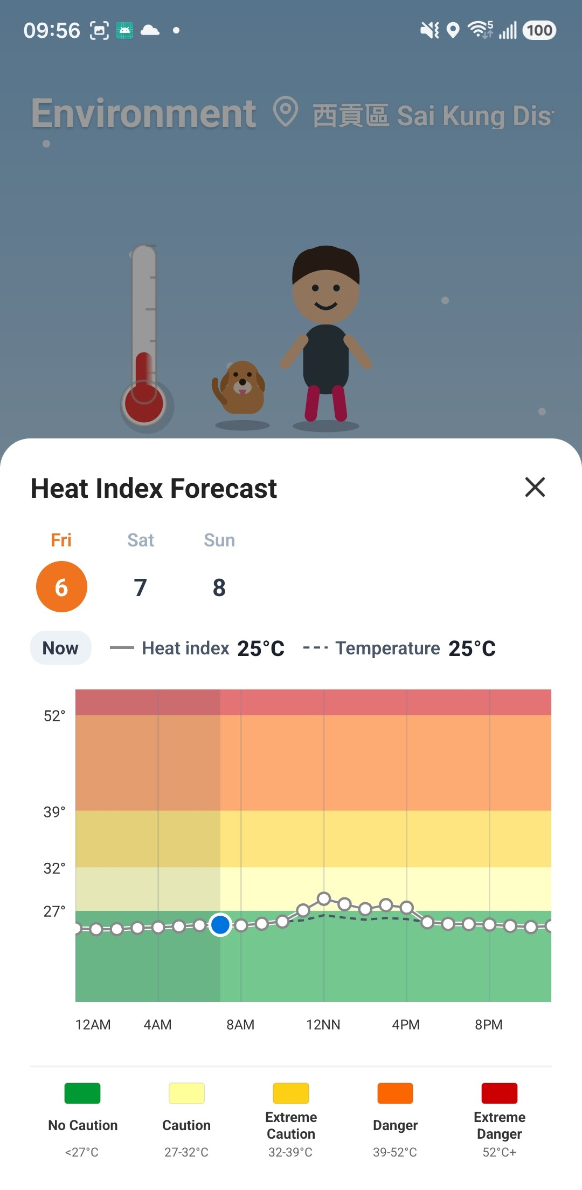
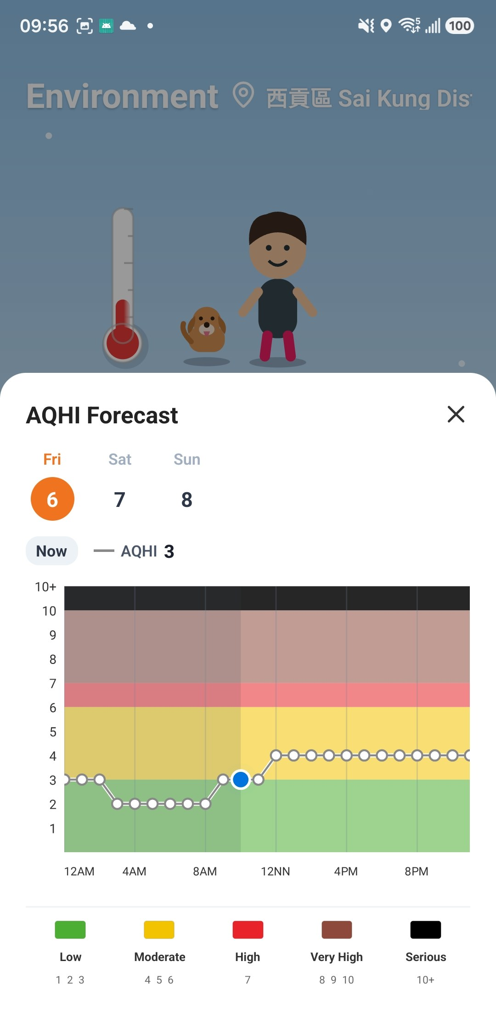
3-day forecast
A2 · Environment
Same chart for both hazards — swipe between days
Coloured bands = risk levels
No Caution → Extreme Danger · Low → Serious
Dot = now, line = hourly
Heat chart also shows temperature (dashed)
Heat and AQHI are peers
Shared chart component, shared day tabs
Heat index
AQHI
Notes:
ForecastSheet → HeatHourlyForecastChart / AqhiHourlyForecastChart, both thin wrappers over HourlyForecastChart.
Heat bands come from HEAT_INDEX_ZONES (src/utils/heatIndexUtils.ts), NWS levels. AQHI bands: Low 1-3, Moderate 4-6, High 7, Very High 8-10, Serious 10+.
Note: the heat API has no forecast yet — future hours replay the reading from 48 h earlier (demo).

Slide 6
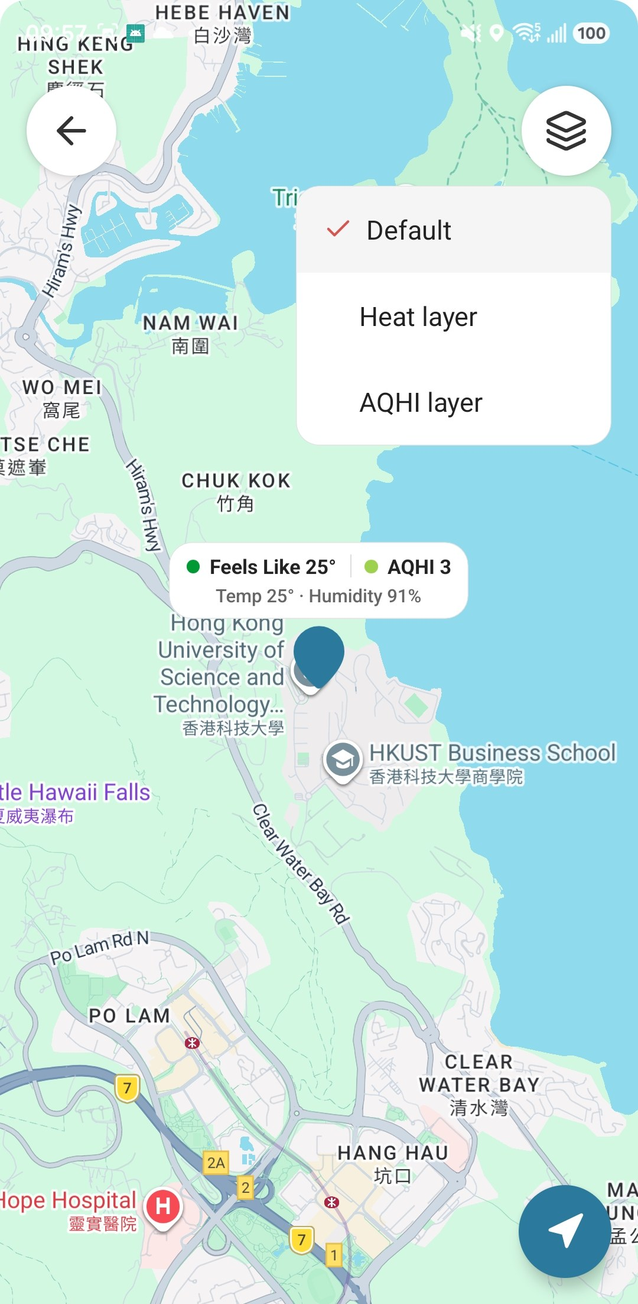
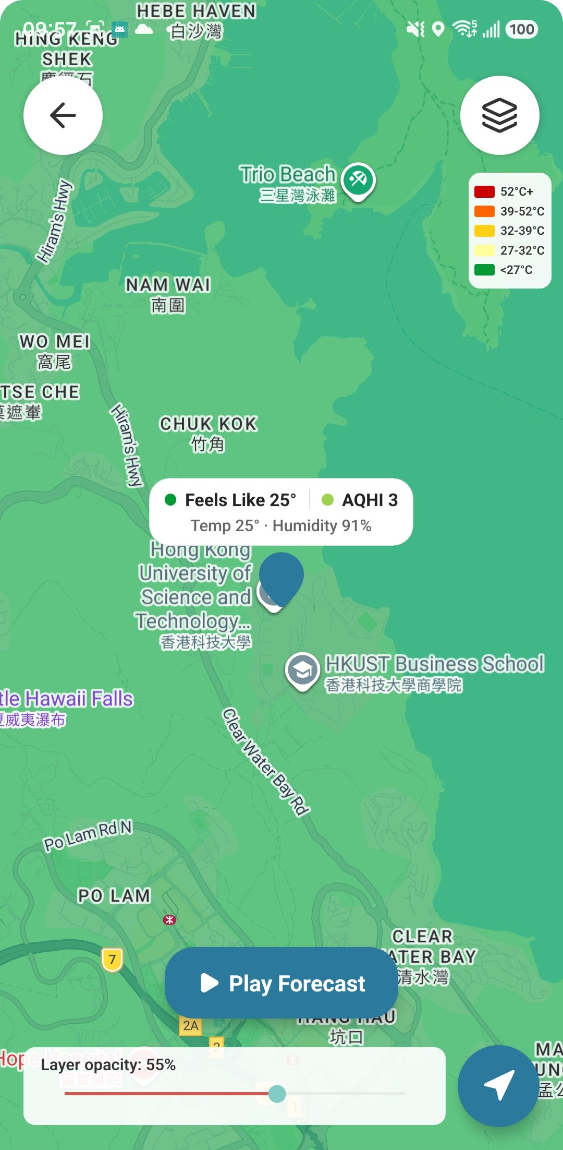
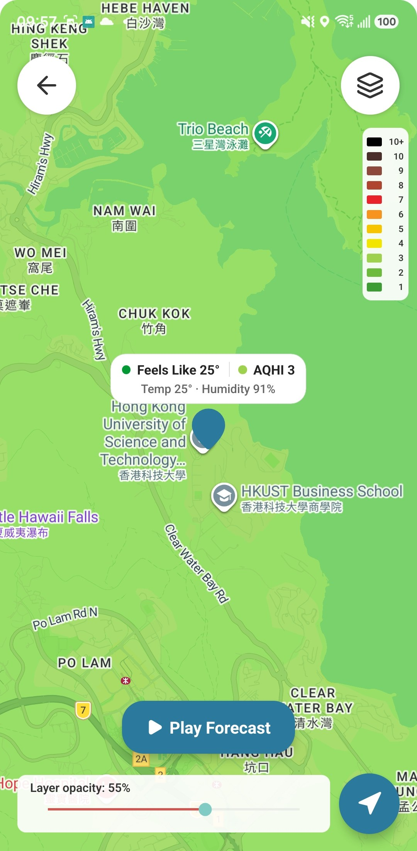
Map layers
A3 · Environment
Switch the map between heat and air quality
1
Tap anywhere
Pin shows both values
2
Play Forecast
Animate the next hours
3
Opacity slider
See streets under it
Choose a layer
Heat layer
AQHI layer
Notes:
MapScreen + MapLayerPicker. Heat layer = server-rendered PNG tiles (useHeatIndexTile / useHeatIndexForecastTiles), clipped to the API data footprint. AQHI layer = street-level AQHI from PRAISE-HK.
Both layers share one opacity slider, a matching vertical legend, and the same frame count/speed for Play Forecast (src/config/mapLayerConfig.ts).

Slide 7

Logic: where the numbers come from
A4 · Environment
One source per hazard — never guessed on the phone
Home cards
Spatial Temperature API
heat index · temp · humidity
Server map tiles
values ready to show
Forecast charts
Map layers
PRAISE-HK API
HKUST · air quality
Street-level AQHI
values ready to show
Place cards
Alert engine
No data? The app shows “--” instead of estimating.
Notes:
Code: src/data/<domain>/ — each domain has types.ts + provider(s) + index.ts switch.
- heat & forecast: API only (src/services/spatialTempApi.ts). Deliberately API-only, so made-up heat data can never reach the screen. Anchored on /{family}/latest because data lands 1–2 h late.
- aqhi & aqhiForecast: real street-level data from PRAISE-HK (src/services/praiseApi.ts).

Slide 8
Exposure
Module B
B1 Two ways to collect
B2 Import a track
B3 Your day so far
B4 Daily & hourly exposure
B5 Your day on the map
B6 Tap a stay or trip
B7 Logic: indoor / outdoor
B8 Logic: data pipeline
Where were you, and how much did it add up to?

Slide 9
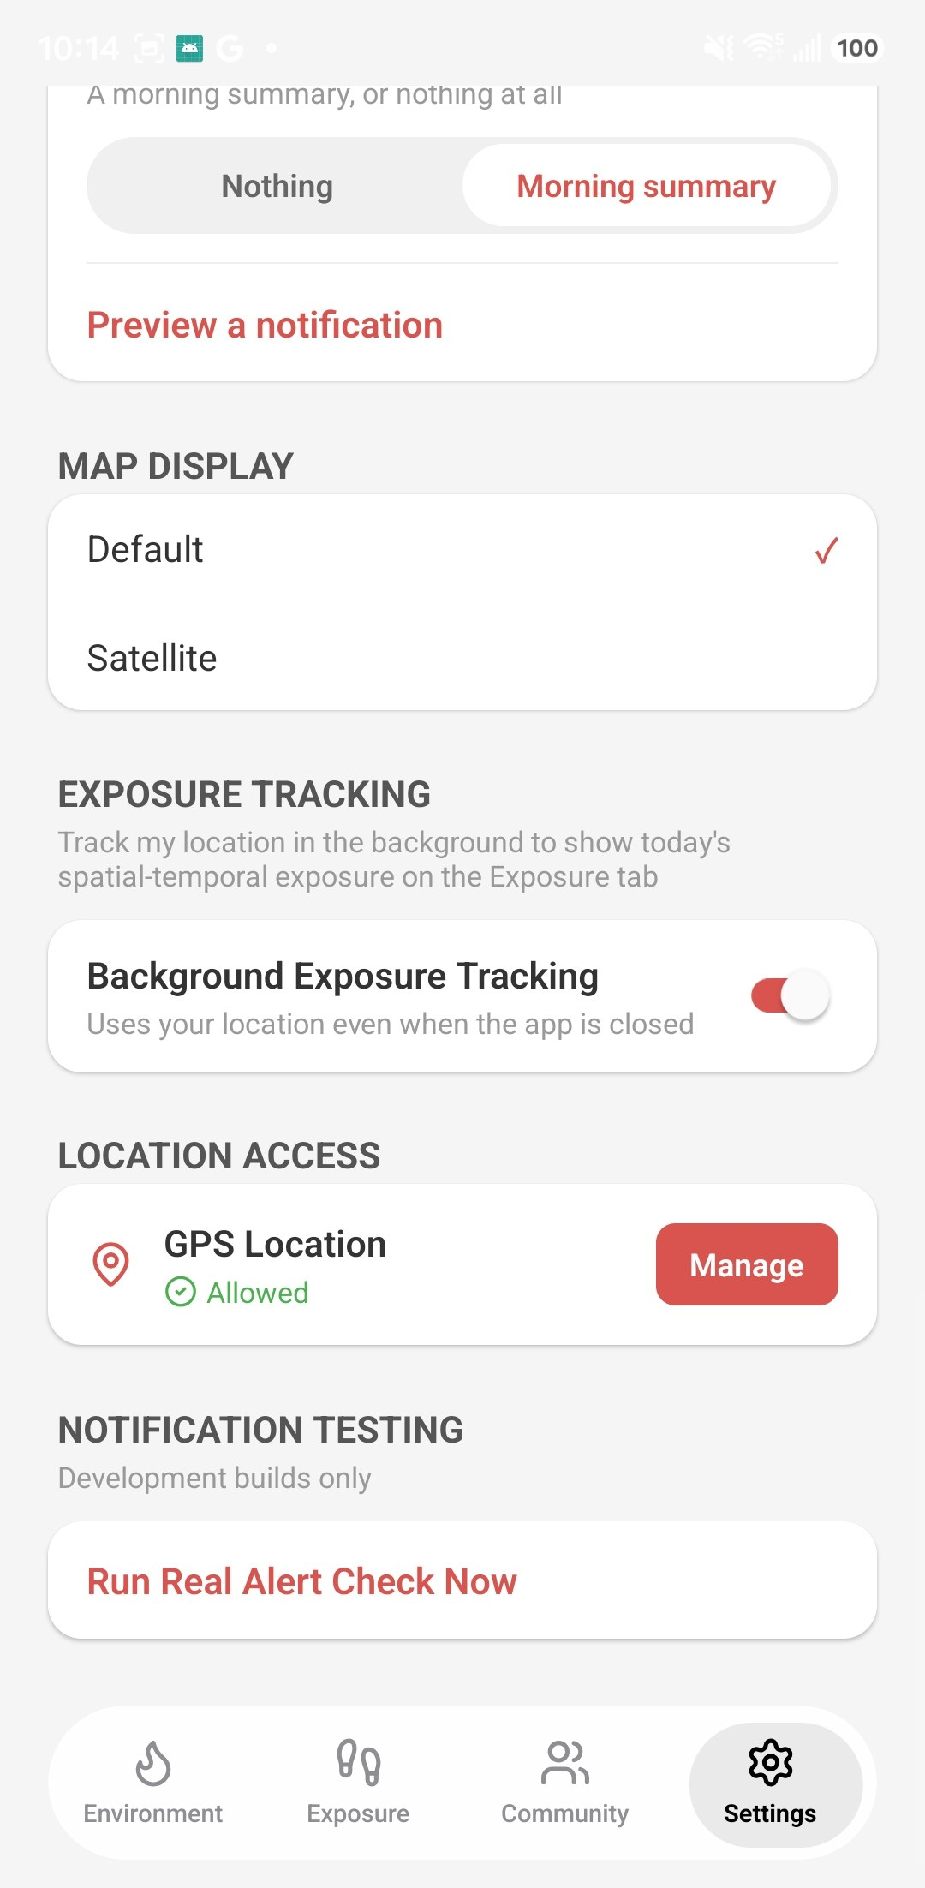
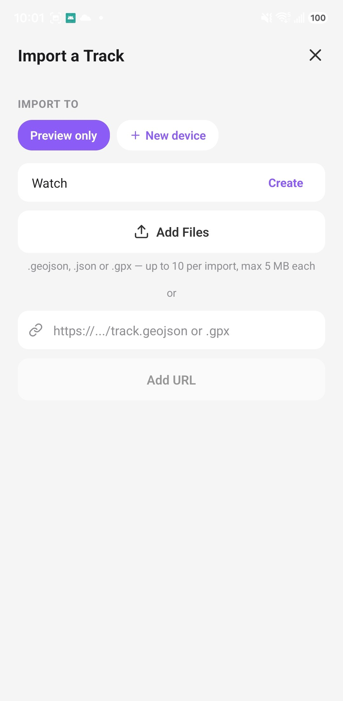
Two ways to collect a day
B1 · Exposure
Automatic tracking, or bring files from another device
Auto
Phone GPS in the background, even when the app is closed
Import
.geojson / .gpx, from a watch or logger app
Settings → Background tracking
Exposure → Import a track
Notes:
Auto: react-native-background-geolocation (src/services/deviceTrackingService.ts). Records a point every 30 m moved, plus a heartbeat every 5 min while still (src/config/exposureTrackingConfig.ts).
Import: ImportTrackModal — up to 10 files per import, 5 MB each, or a URL. Each source is a 'device' (e.g. Watch) with its own history.

Slide 10
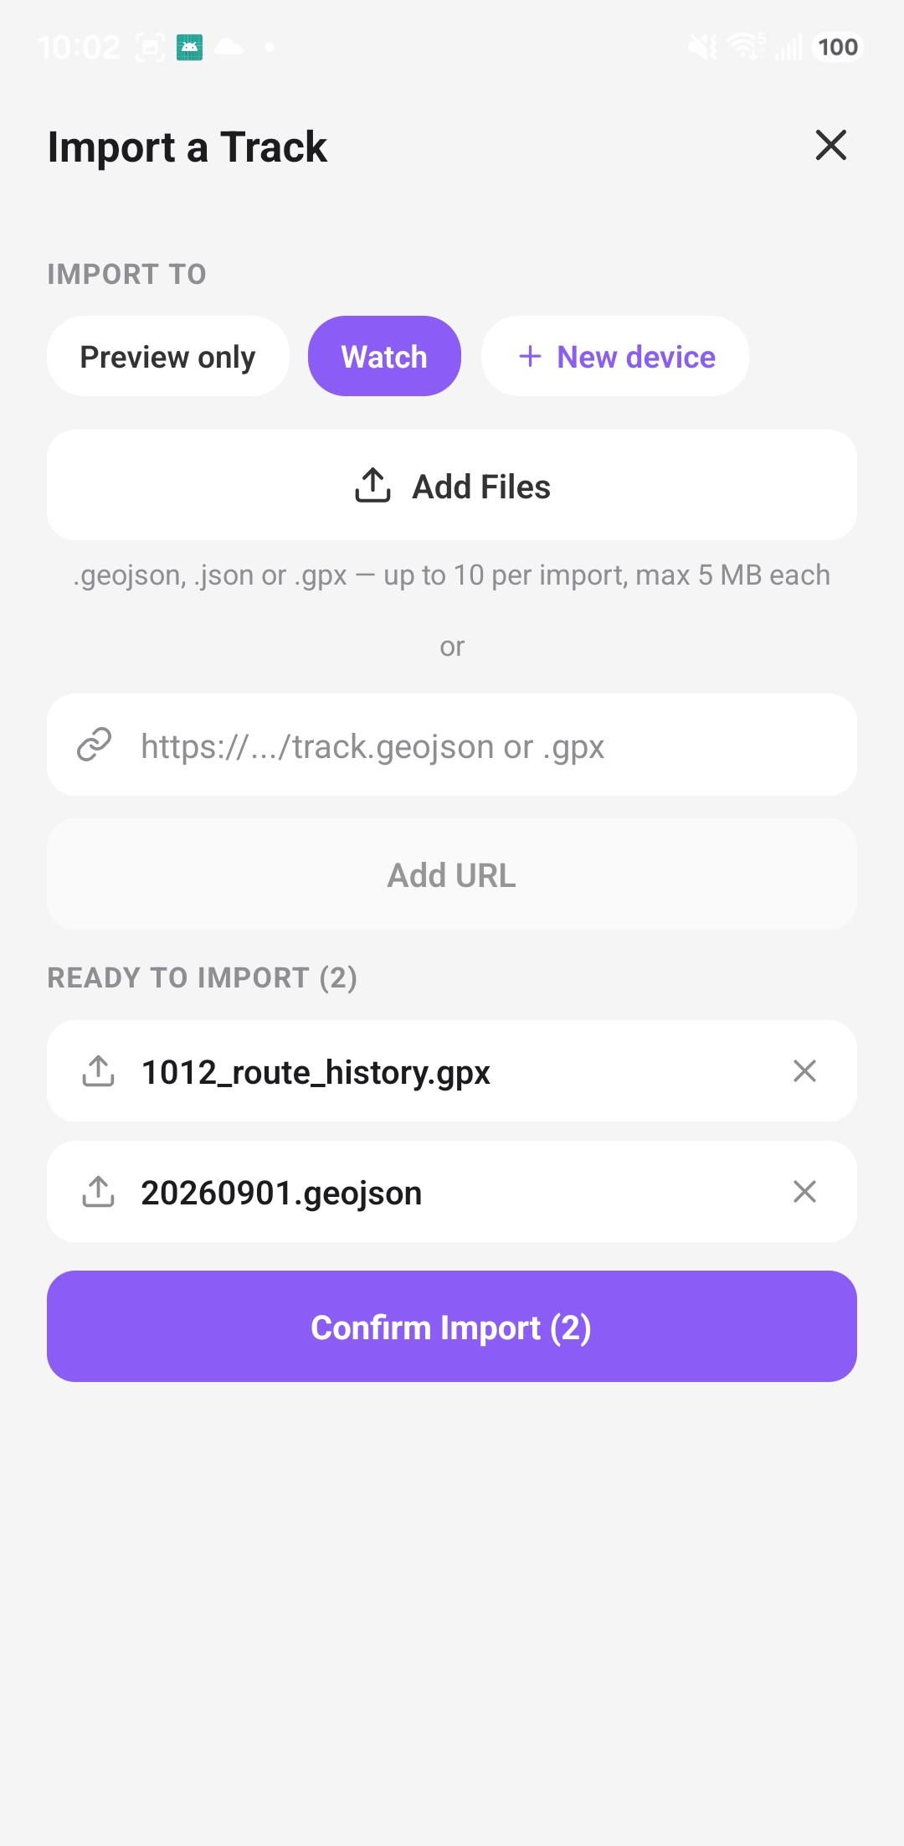
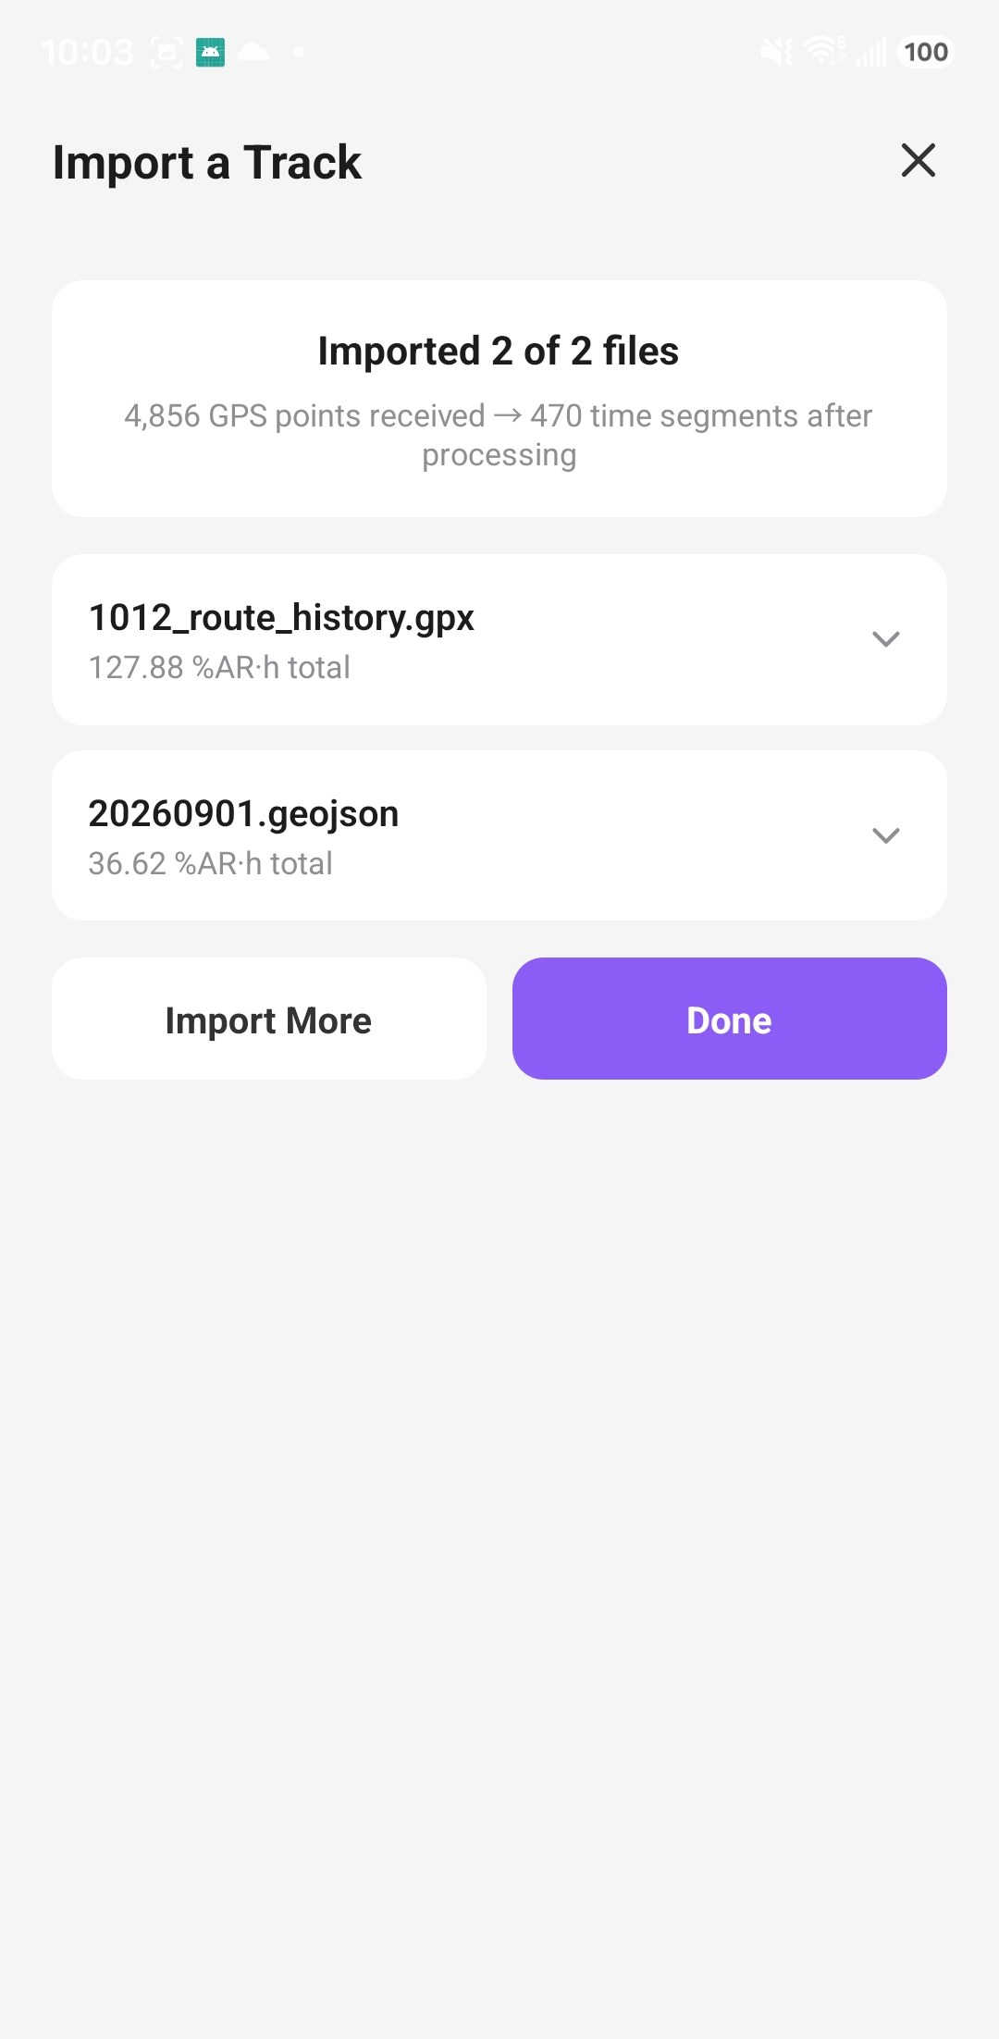

Import a track in 3 steps
B2 · Exposure
Pick a device, add files, confirm
4,856
GPS points received
470
time segments after processing
1 Choose / create device
2 Add files
3 Done
Notes:
Upload goes to the exposure backend (POST /ingest for GeoJSON, POST /ingest/gpx for GPX). The backend queues a background batch; the app polls GET /ingest/{batch_id} and shows progress.
Why fewer segments than points: a whole stay becomes one point, routes are thinned — so a smaller number is not lost data. 'Preview only' imports without saving to a device.

Slide 11
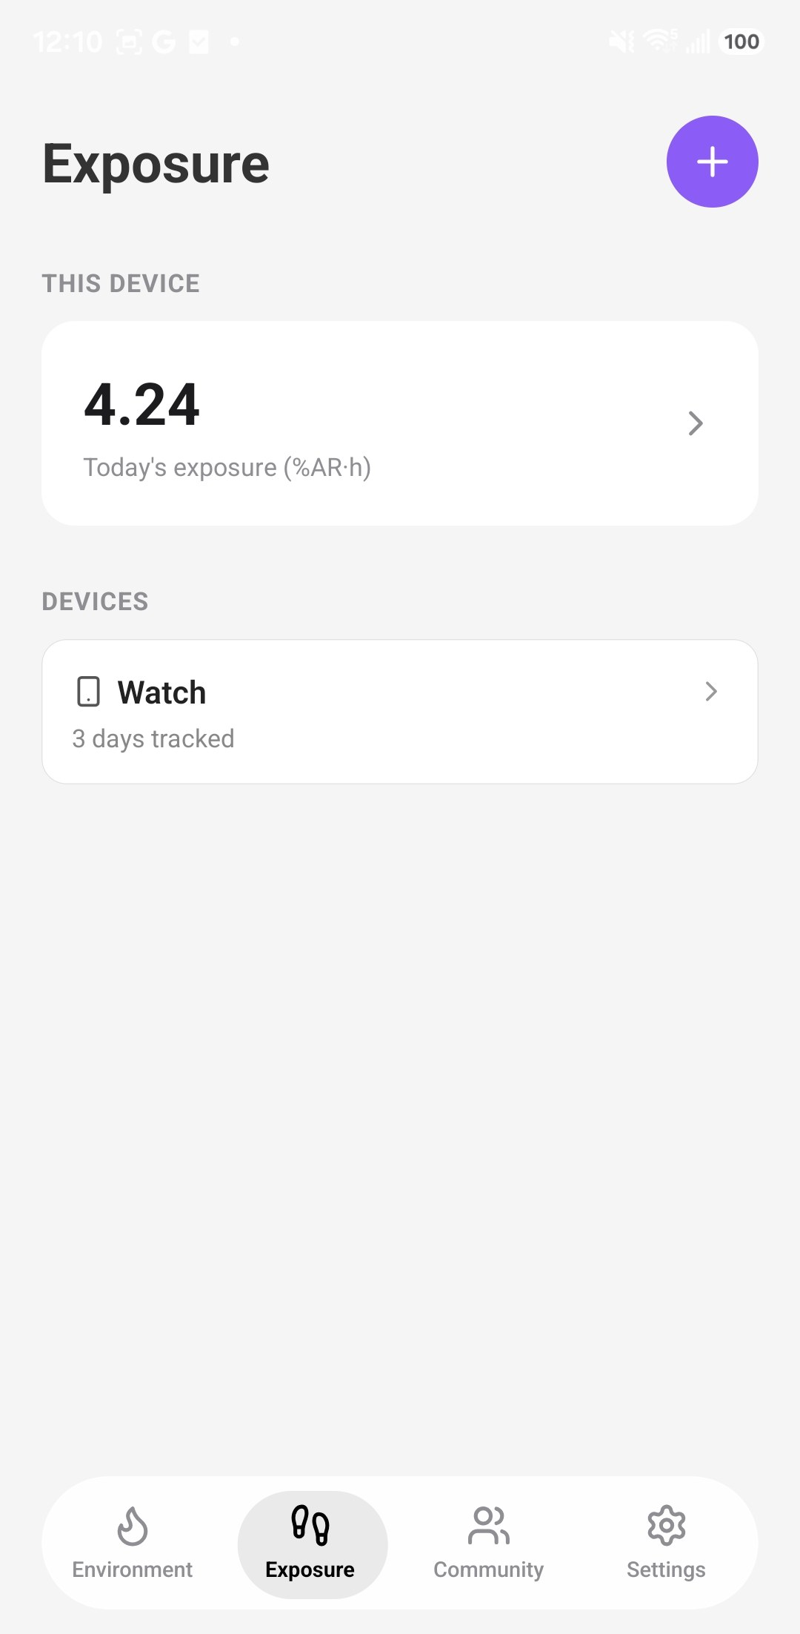
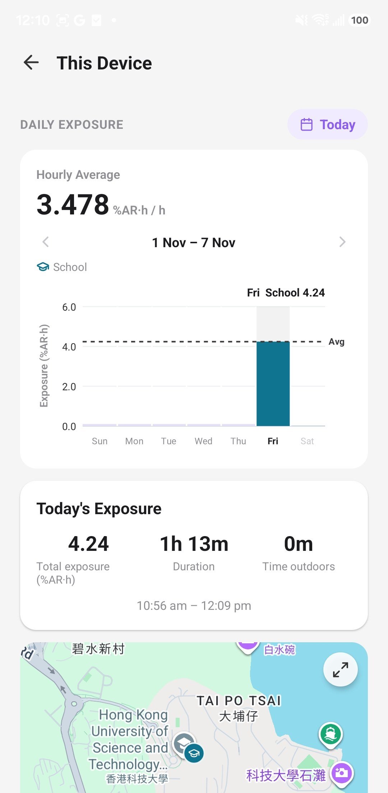
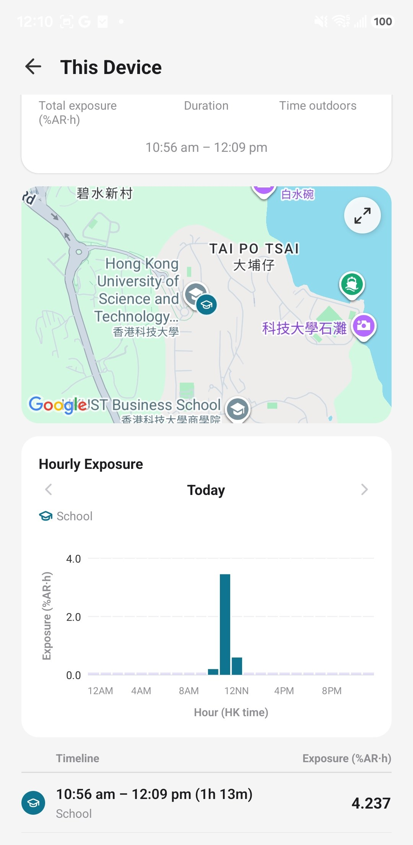
Your day so far
B3 · Exposure
Open the Exposure tab — today’s number first, details one tap away
1
Today first
This phone’s exposure, then other devices
2
Three numbers
Total · tracked time · time outdoors
3
Timeline
Each stay or trip with its own exposure
Exposure tab
Today’s exposure
Hourly + timeline
Notes:
Exposure tab home: 'This device' card (today's exposure from background tracking) + a list of other devices (e.g. Watch — 3 days tracked).
This Device screen: weekly chart, a Today's Exposure card (total %AR·h, tracked duration, time outdoors, first–last time), the map, hourly chart and a timeline list — one row per stay/trip with its type icon and exposure.
Example shown: 10:56 am – 12:09 pm at School, 4.24 %AR·h, 0 m outdoors.

Slide 12
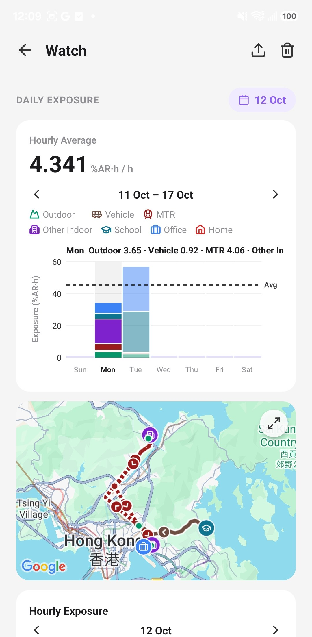
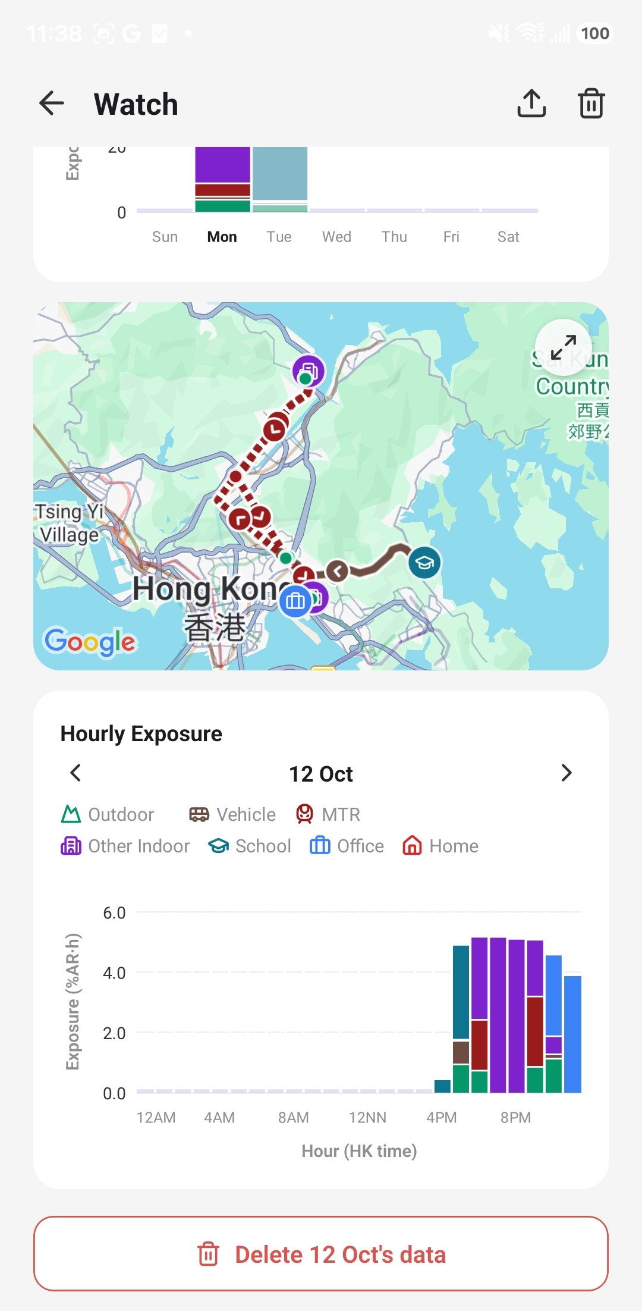
Daily and hourly exposure
B4 · Exposure
Each bar is split by where you were
4.341
%AR·h per hour · hourly average, 11–17 Oct
= week’s total ÷ hours tracked — fair for part-tracked days
7 place types, one colour each
Outdoor
School
Vehicle
Office
MTR
Home
Other Indoor
Same colours and icons on the chart and the map
Week view
Hourly view
Notes:
Headline = HOURLY average: the week's total exposure ÷ hours actually tracked (src/utils/exposureWeekStats.ts computeWeekStats). A day tracked for only part of its 24 h no longer reads as a low-exposure day, and week-over-week comparison is fair. The dashed line on the bars is still the daily average (same scale as the day bars). Shown with 3 decimals because per-hour values are small.
ExposureWeekCard (Sun–Sat, swipeable), ExposureHourlyPager (day by day). Stack order bottom→top: Outdoor first because it drives exposure most and only the bottom layer is comparable across bars.
Unit %AR·h is computed by the backend (expo_calx) — explain in your own words for the audience.
Colours and legend icons: src/config/exposureIoConfig.ts. Export button (top right) shares a report; trash deletes a day.

Slide 13
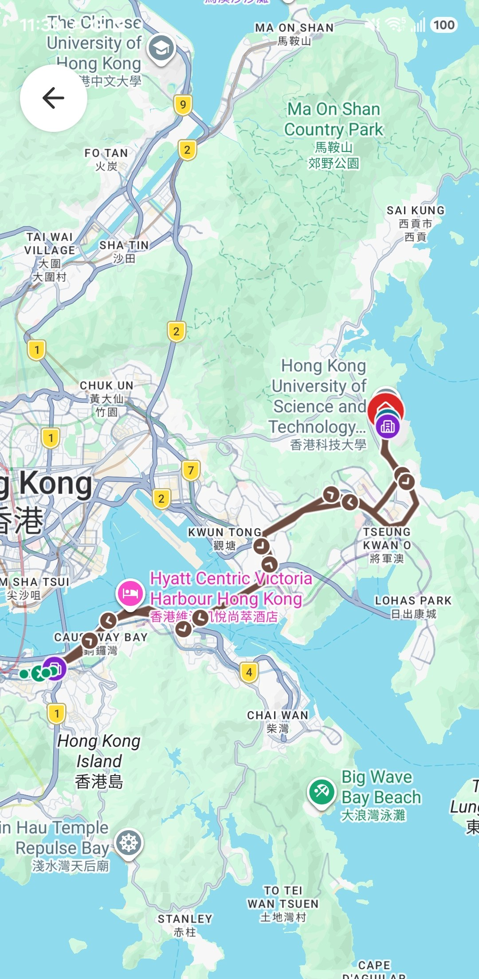
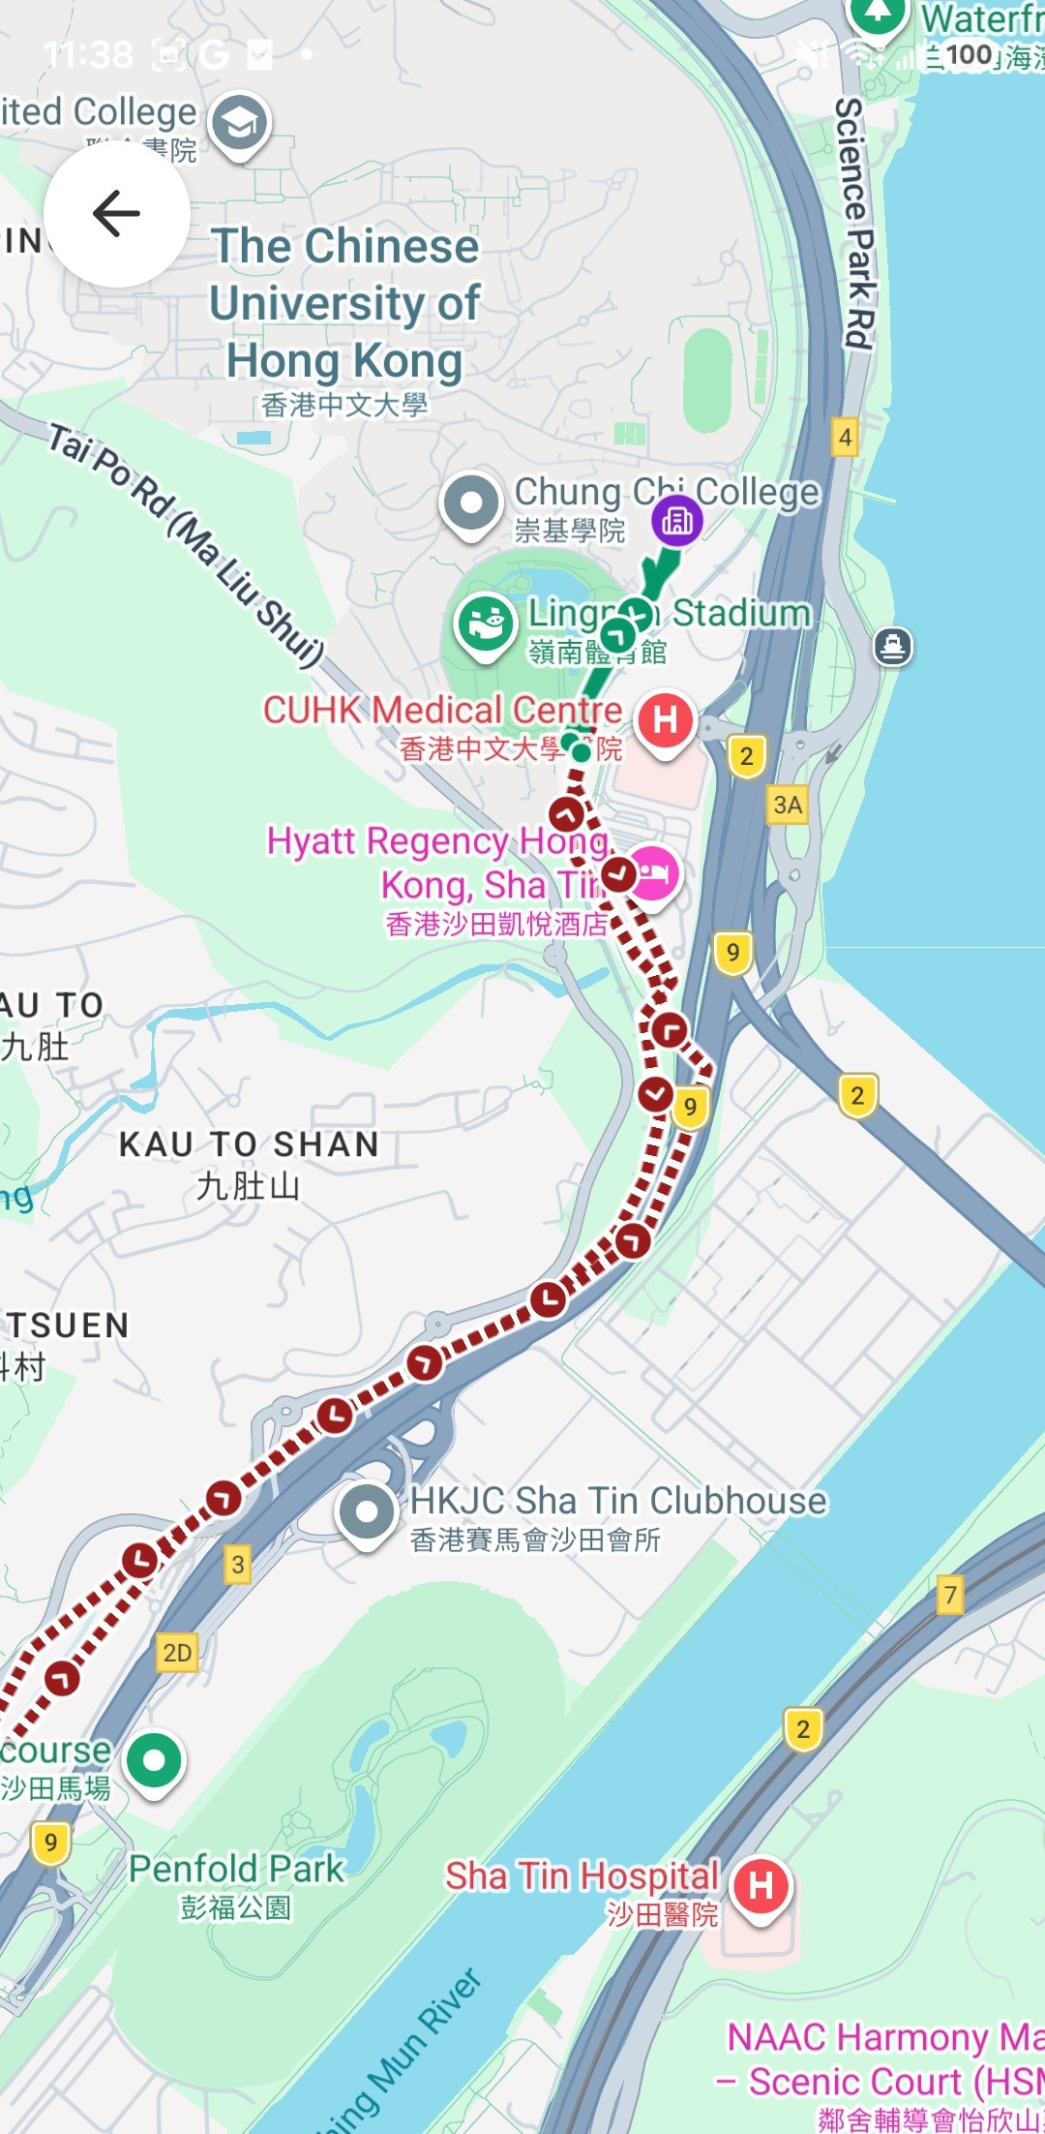
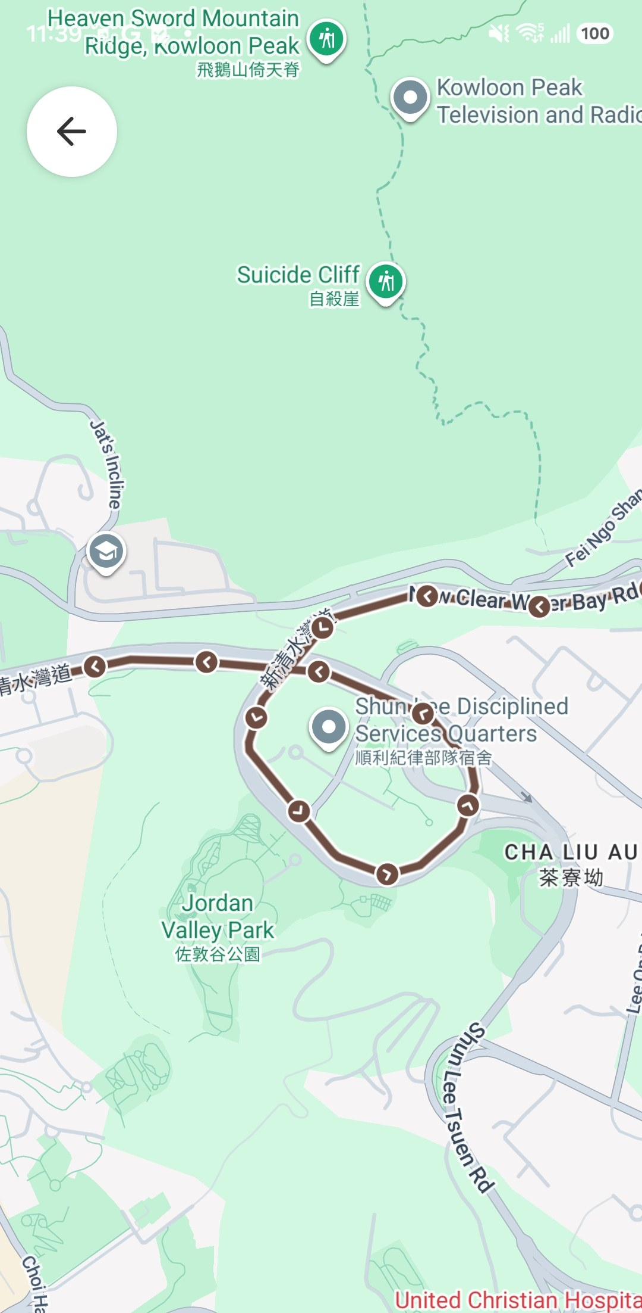
Your day on the map
B5 · Exposure
Line style tells you how you moved
1
Arrows
Direction of travel
2
Dashed red
MTR ride
3
Icons
Stays: home, school, office…
Whole day
Walk (green) + MTR
Vehicle (brown)
Notes:
ExposureTrajectoryMap. Stays are dots/icons, routes are lines with direction arrows. Every MTR ride is drawn dashed (underground has no GPS, so the straight line between stations is a guess). Points outside Hong Kong are drawn grey — they have no exposure score, which is not the same as zero.

Slide 14
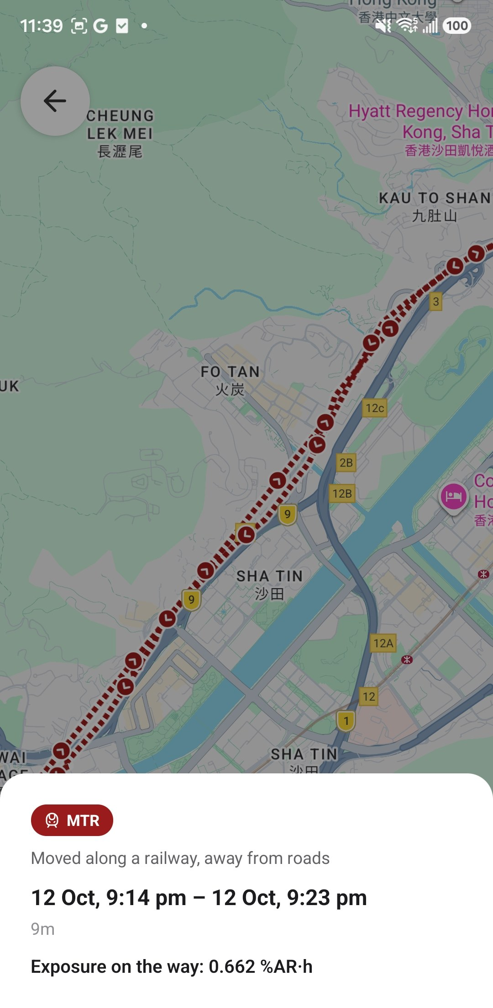
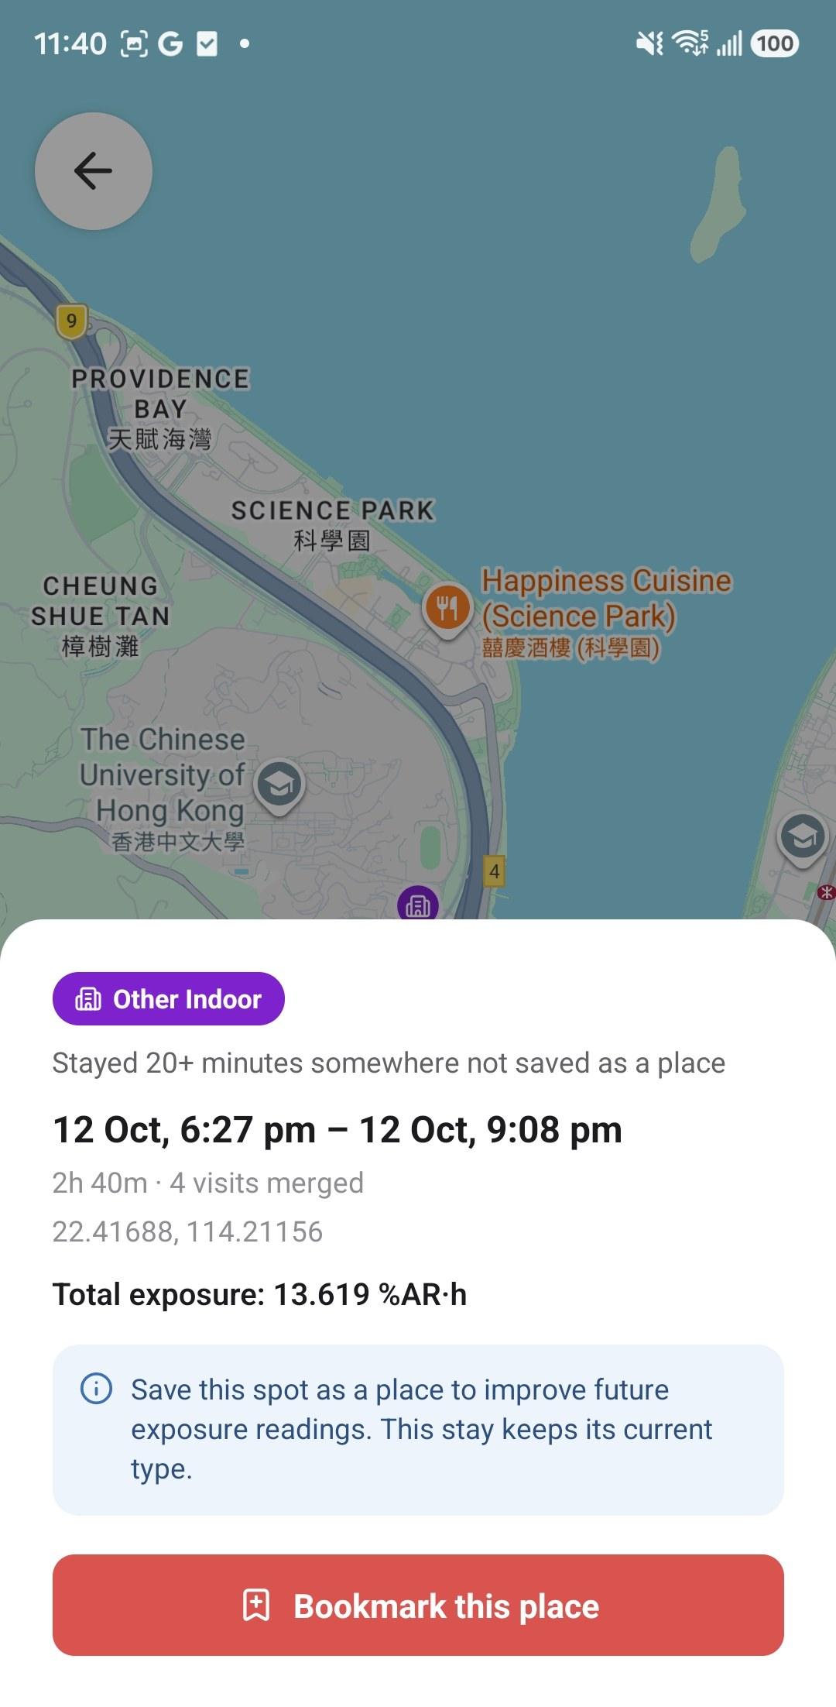
Tap a stay or a trip
B6 · Exposure
Every piece explains itself — and can be corrected
1
What and why
“Moved along a railway, away from roads”
2
When and how much
Time, duration, exposure for this piece
3
Bookmark this place
Saves it as a place → better readings next time
Trip
Stay
Notes:
ExposureTripSheet / ExposureStaySheet. The 'why' line maps the backend's reason code to plain words (EXPOSURE_IO_REASON_TEXT): rail, jump, vehicle, walk, place_label, night_stay, short_stop, long_stay…
'4 visits merged' = nearby stays clustered into one. Example shown: an unsaved restaurant stay typed Other Indoor — bookmark it to give it a type. Bookmarking opens the Add place flow (module C).

Slide 15
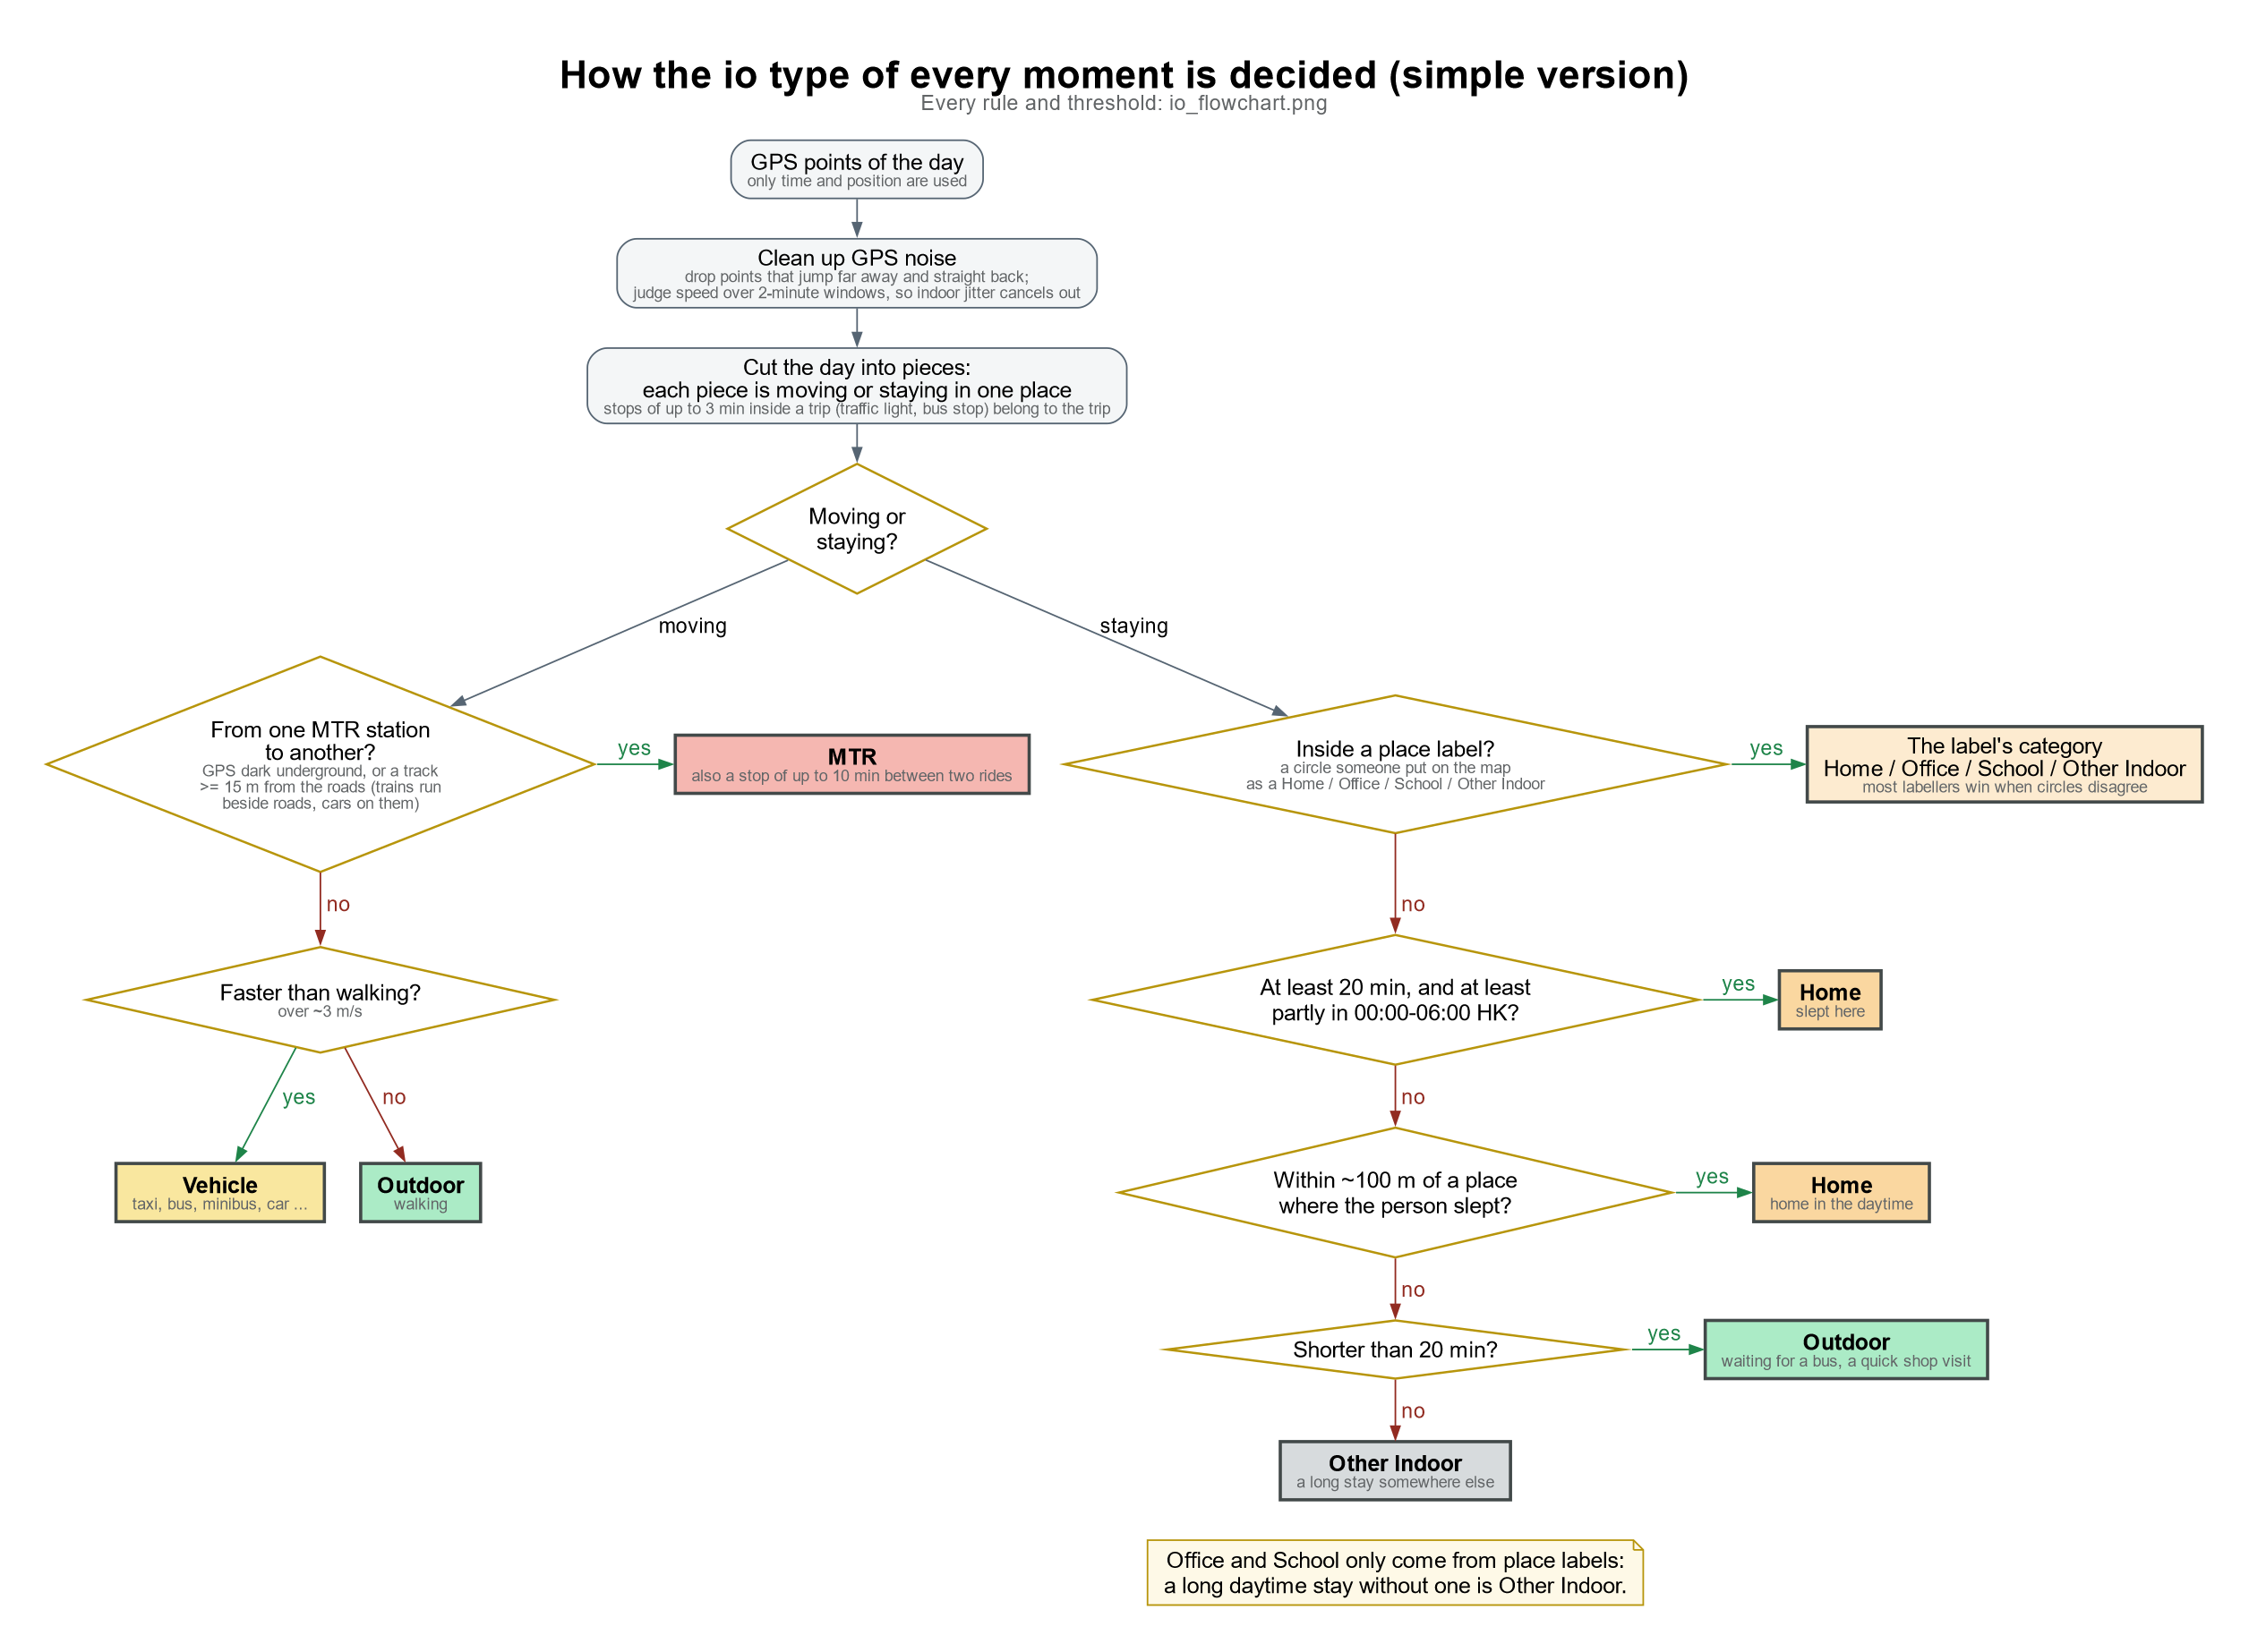
Logic: indoor or outdoor?
B7 · Exposure
Every moment gets one of 7 types
Moving
MTR → else Vehicle (> ~3 m/s) → else Outdoor walk
Staying in a saved place
Takes the place’s type
Staying overnight / near it
Home
Short stop < 20 min
Outdoor
Long stop elsewhere
Other Indoor
Notes:
Runs on the exposure backend. Clean GPS noise (drop far jumps, judge speed over 2-min windows) → cut the day into moving/staying pieces (stops ≤3 min inside a trip stay in the trip) → classify.
Office and School only come from place labels — a long daytime stay without one is Other Indoor. When labels disagree, most labellers win.

Slide 16
Logic: from GPS to chart
B8 · Exposure
Phone collects, server classifies and scores
Server
Phone
GPS ping or file
Upload
POST /ingest → queued batch
Clean & cut
noise out, moving vs staying
Classify & score
7 types · exposure (HK only)
App
week · hourly · map · export
GET /exposure/hourly/{device} returns one row per stay or route point, already split by clock hour
Notes:
Client code: src/services/exposureApi.ts, src/data/exposure/apiExposureProvider.ts, src/utils/hourlyExposureAdapter.ts.
Each expo_calx call takes ~20–30 s server-side; the app uploads files in parallel and polls batch status. Rows carry io, reason, kind (stay/route), road name, in_hk.

Slide 17
Community places
Module C
C1 Add a place in 3 steps
C2 Who’s there sets the alert
C3 Places at a glance
C4 Logic: places improve exposure
The places that matter — and who is there

Slide 18
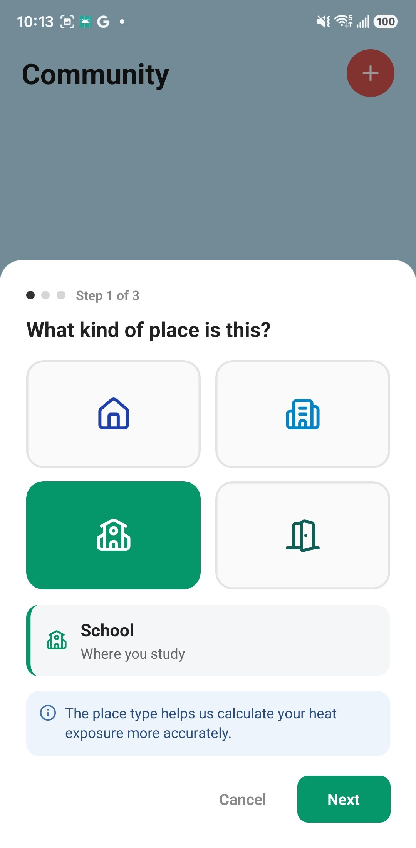
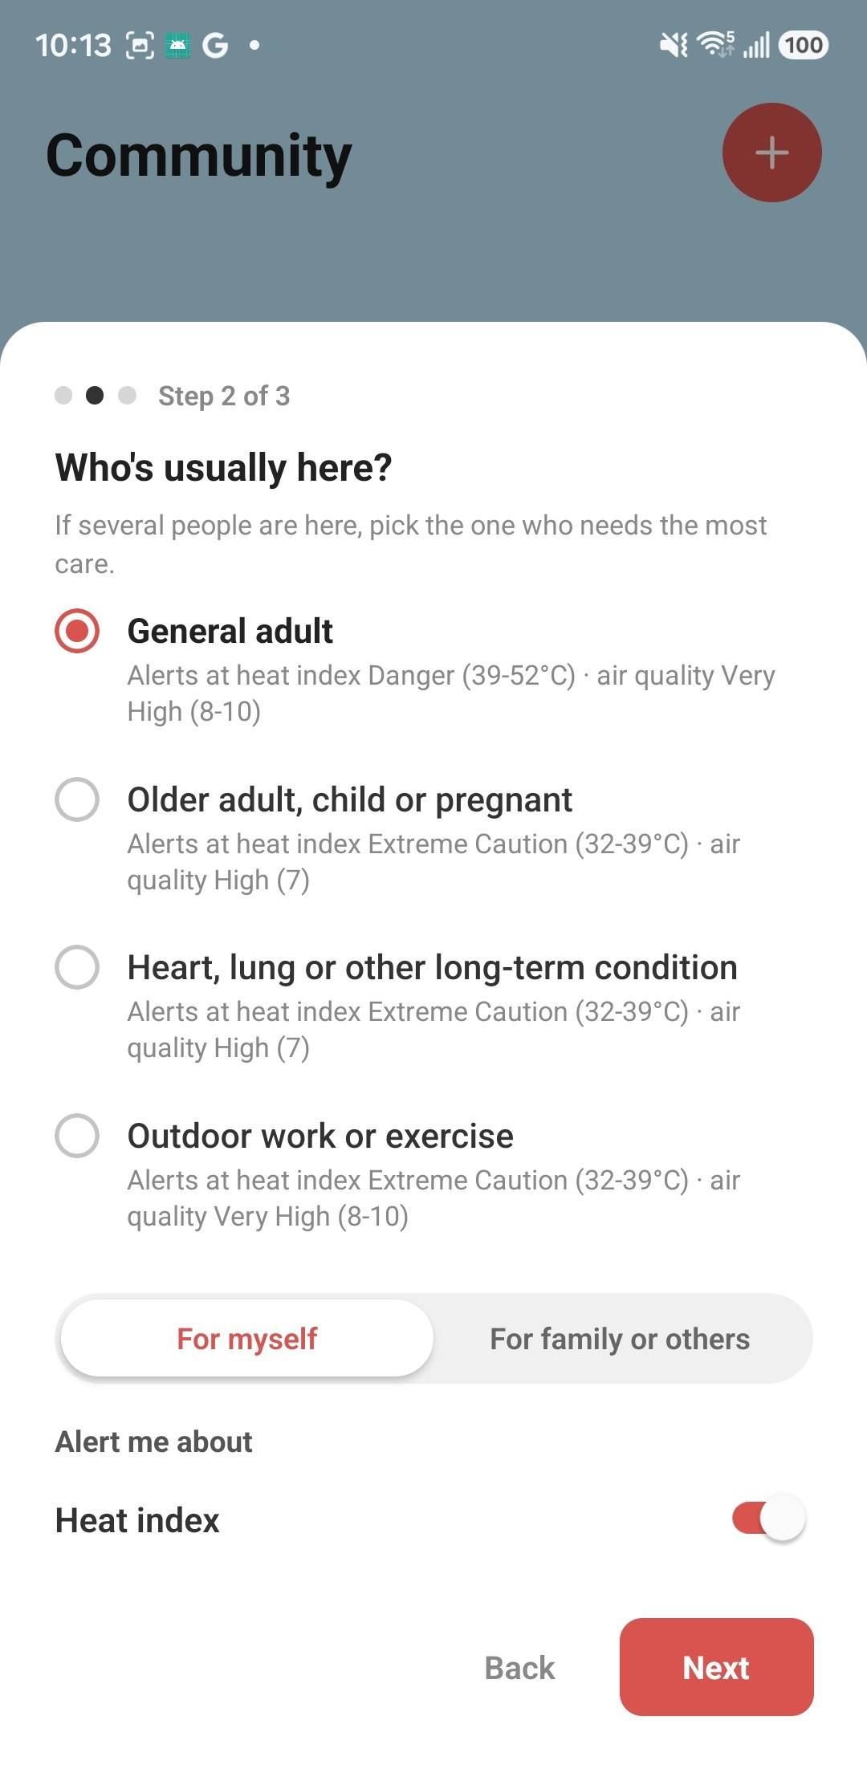
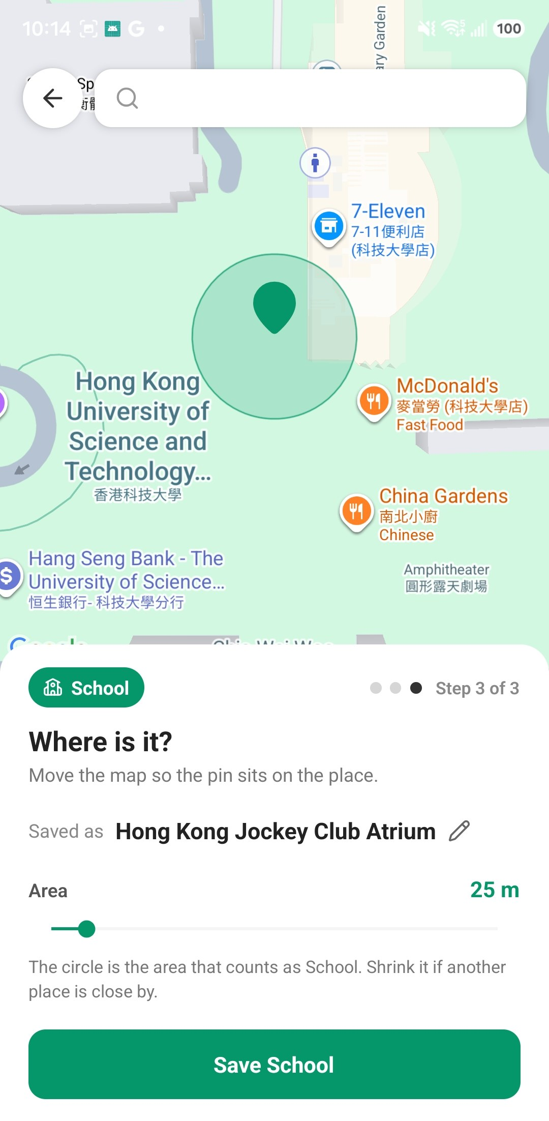
Add a place in 3 steps
C1 · Community places
Type → who is there → where
1
4 types
Home, Office, School, Other
2
Auto name
Looked up from the map
3
Area
Shrink if places are close
1 What kind of place
2 Who’s usually here
3 Pin + area circle
Notes:
+ button on Community tab → AddBookmarkModal (src/components/addPlace/*). Place name comes from reverse geocoding (placeLookupService); user can edit it. Radius slider sets the circle that counts as this place.

Slide 19
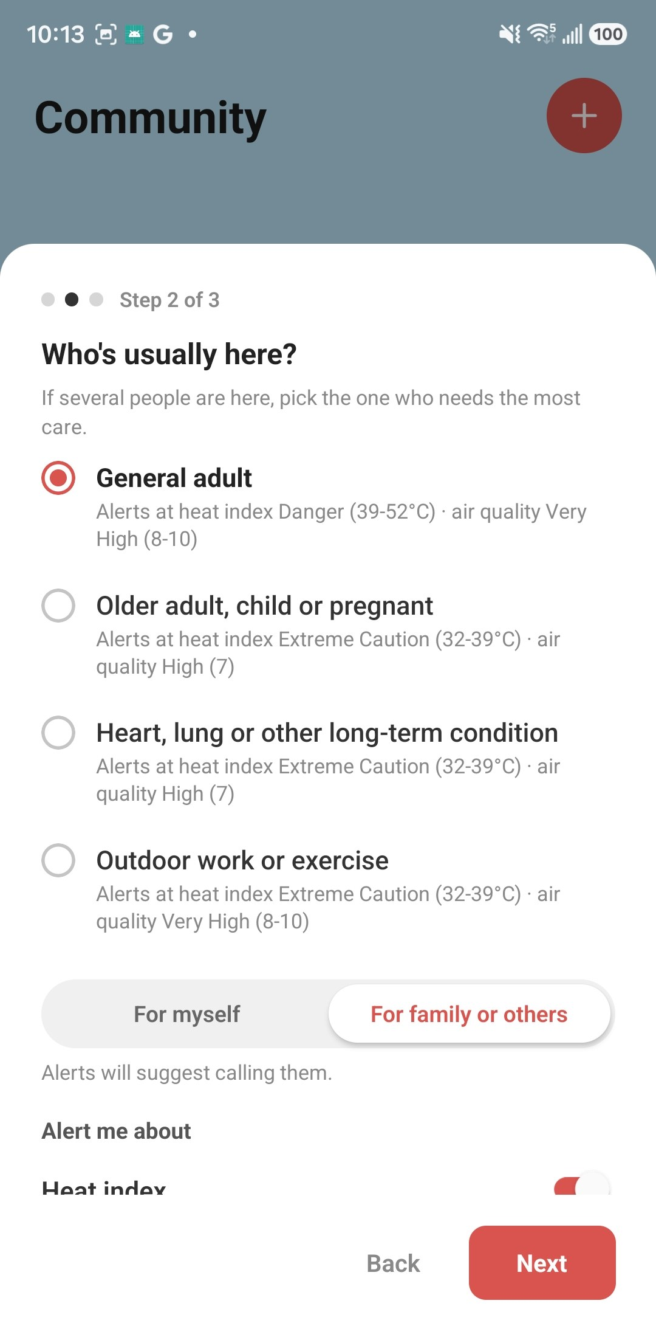
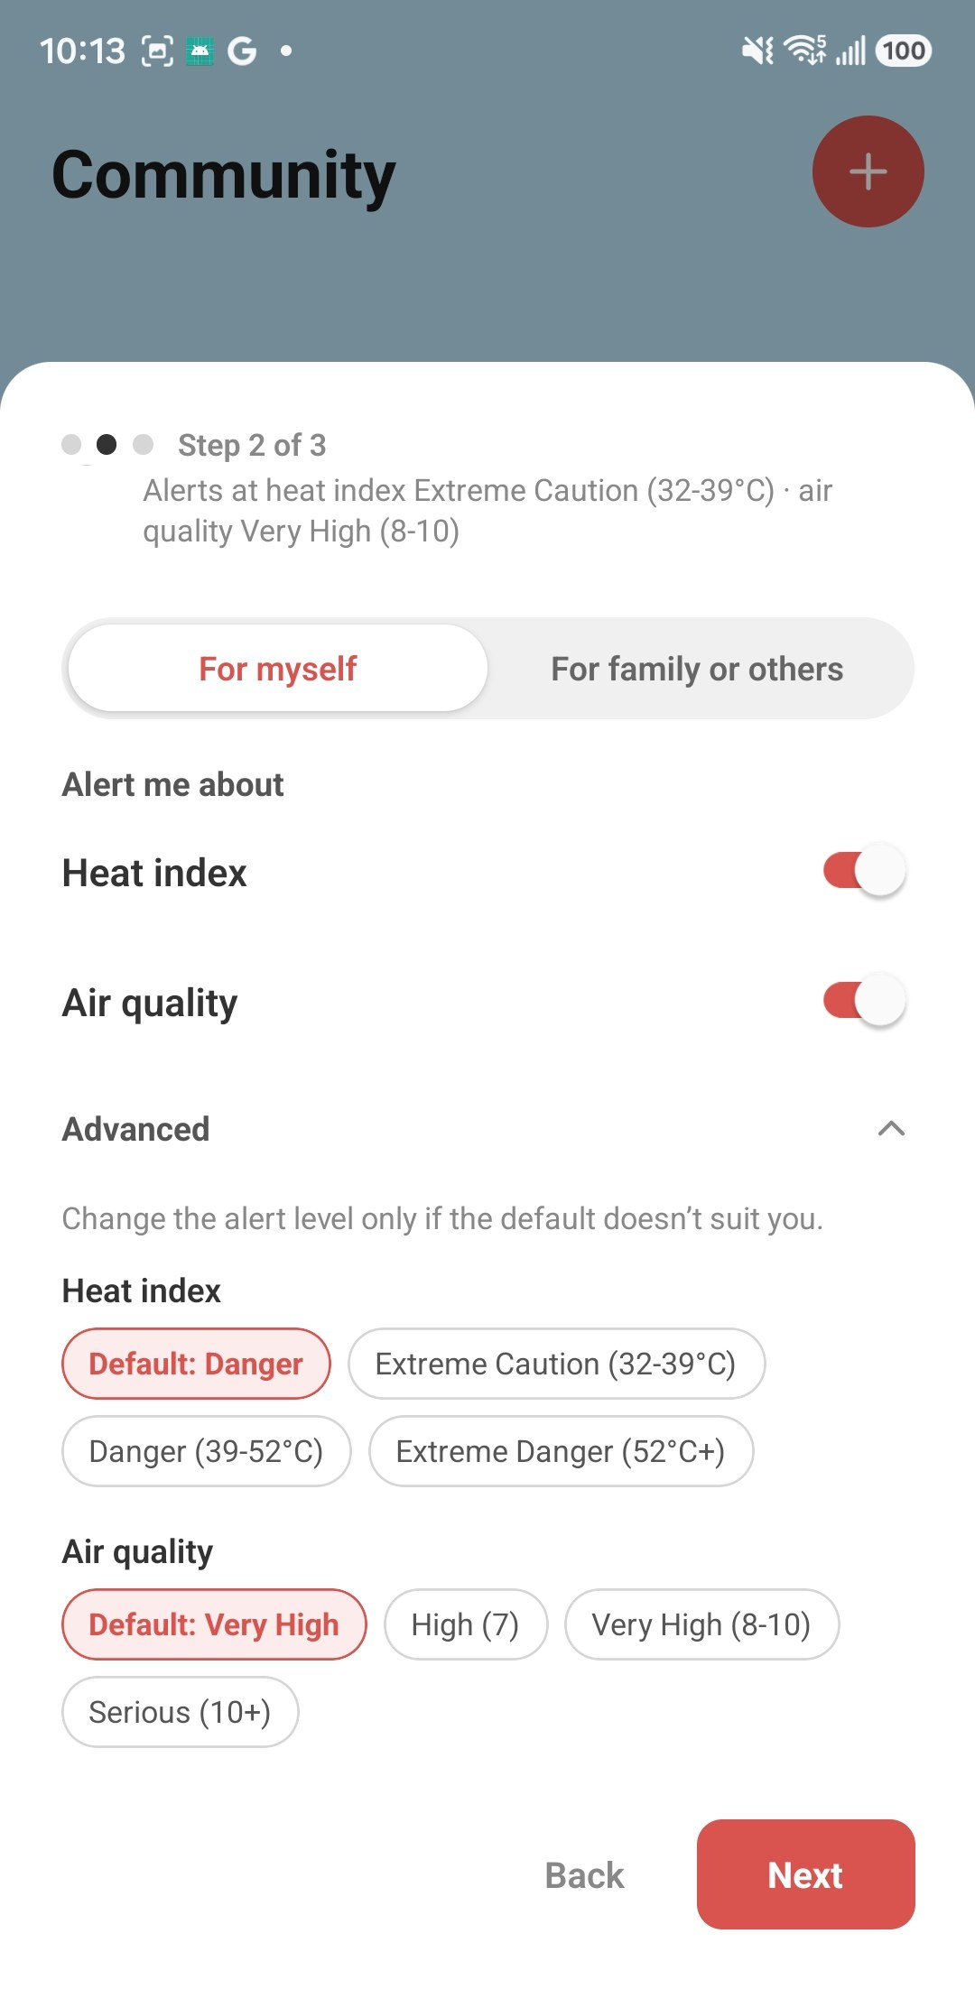
Who’s there sets the alert level
C2 · Community places
Ask about people, not thresholds
Who is here | Heat index | AQHI
General adult | Danger 39°C+ | Very High 8+
Older adult, child, pregnant | Extreme Caution 32°C+ | High 7+
Heart / lung condition | Extreme Caution 32°C+ | High 7+
Outdoor work / exercise | Extreme Caution 32°C+ | Very High 8+
Alerts start at the level shown
For family → “call them”
Advanced override
Notes:
AUDIENCE_ALERT_LEVELS in src/config/alertConfig.ts. AQHI levels follow EPD health advice; heat uses NWS heat index levels (app's proposal — still needs public-health review).
'For family or others' changes the wording to 'call to remind them' and turns on the all-clear message by default. Advanced lets users pick a level; levels below Extreme Caution / High are not offered.

Slide 20
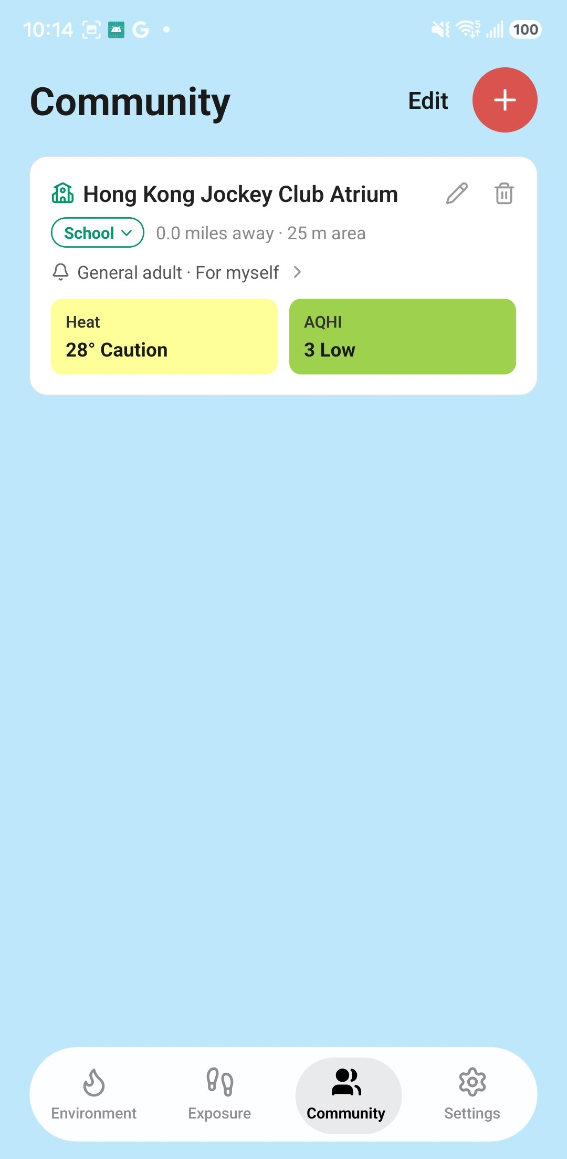
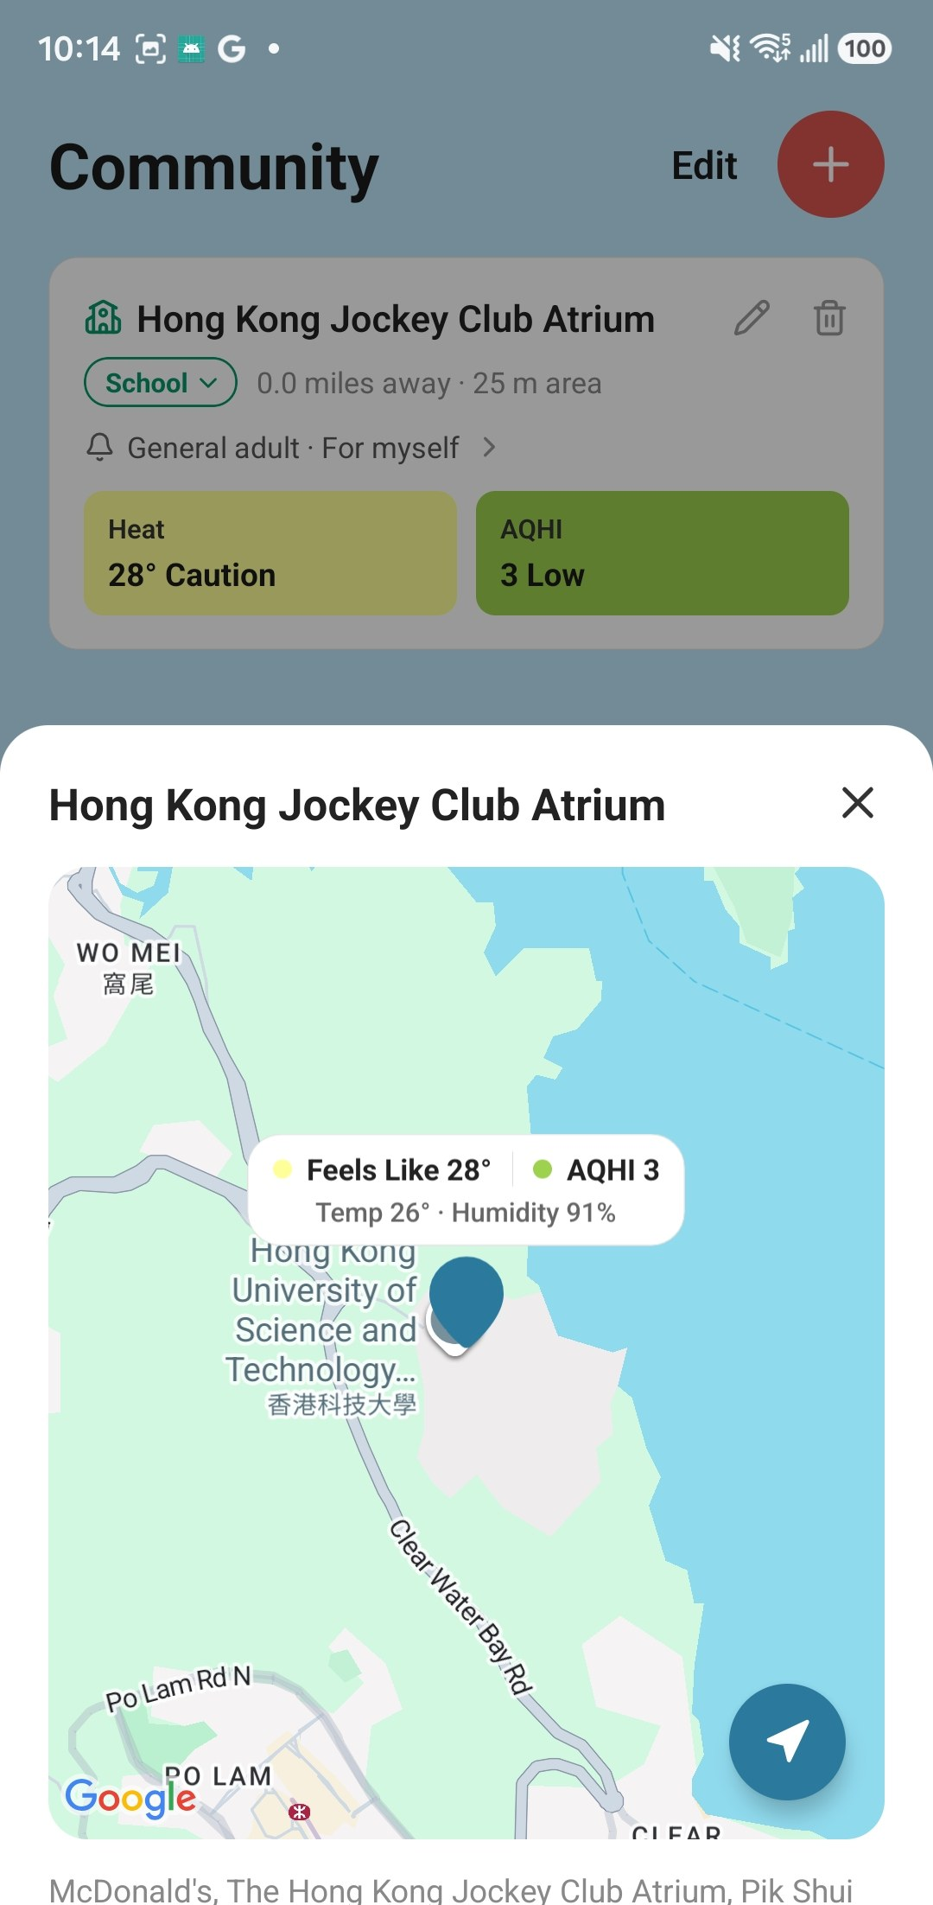
Places at a glance
C3 · Community places
Live heat and air quality for every saved place
1
Both hazards per place
Heat 28° Caution · AQHI 3 Low
2
Alert profile in one line
“General adult · For myself” → tap to change
3
Edit mode
Rename, change type, drag to reorder, hide
Place list
Tap → map
Notes:
CommunityScreen + BookmarkCard. Values via usePlacesHeatIndex / usePlacesAqhi (both wrap usePlaceValues). Type chip opens ChangePlaceTypeModal; Edit enables drag reorder (DraggableList).

Slide 21


Logic: saved places improve exposure
C4 · Community places
A place you save teaches the server what a stay was
You save a place
type + area circle
Sent as a place label
type and circle only
Stays inside the circle
take that type
Better exposure
School / Office instead of “Other Indoor”
Who is there (alert profile) stays on the phone — never uploaded.
Labels are shared: when circles disagree, most labellers win.
Notes:
src/services/placeLabelSyncService.ts syncs labels whenever the exposure backend is configured. BookmarkEntry.alertProfile is phone-only and never bumps updatedAt, so editing it never re-uploads the label.

Slide 22
Alerts & settings
Module D
D1 Alerts that fit you
D2 One event, few messages
D3 Logic: alert check pipeline
A few messages per episode — not one per reading

Slide 23
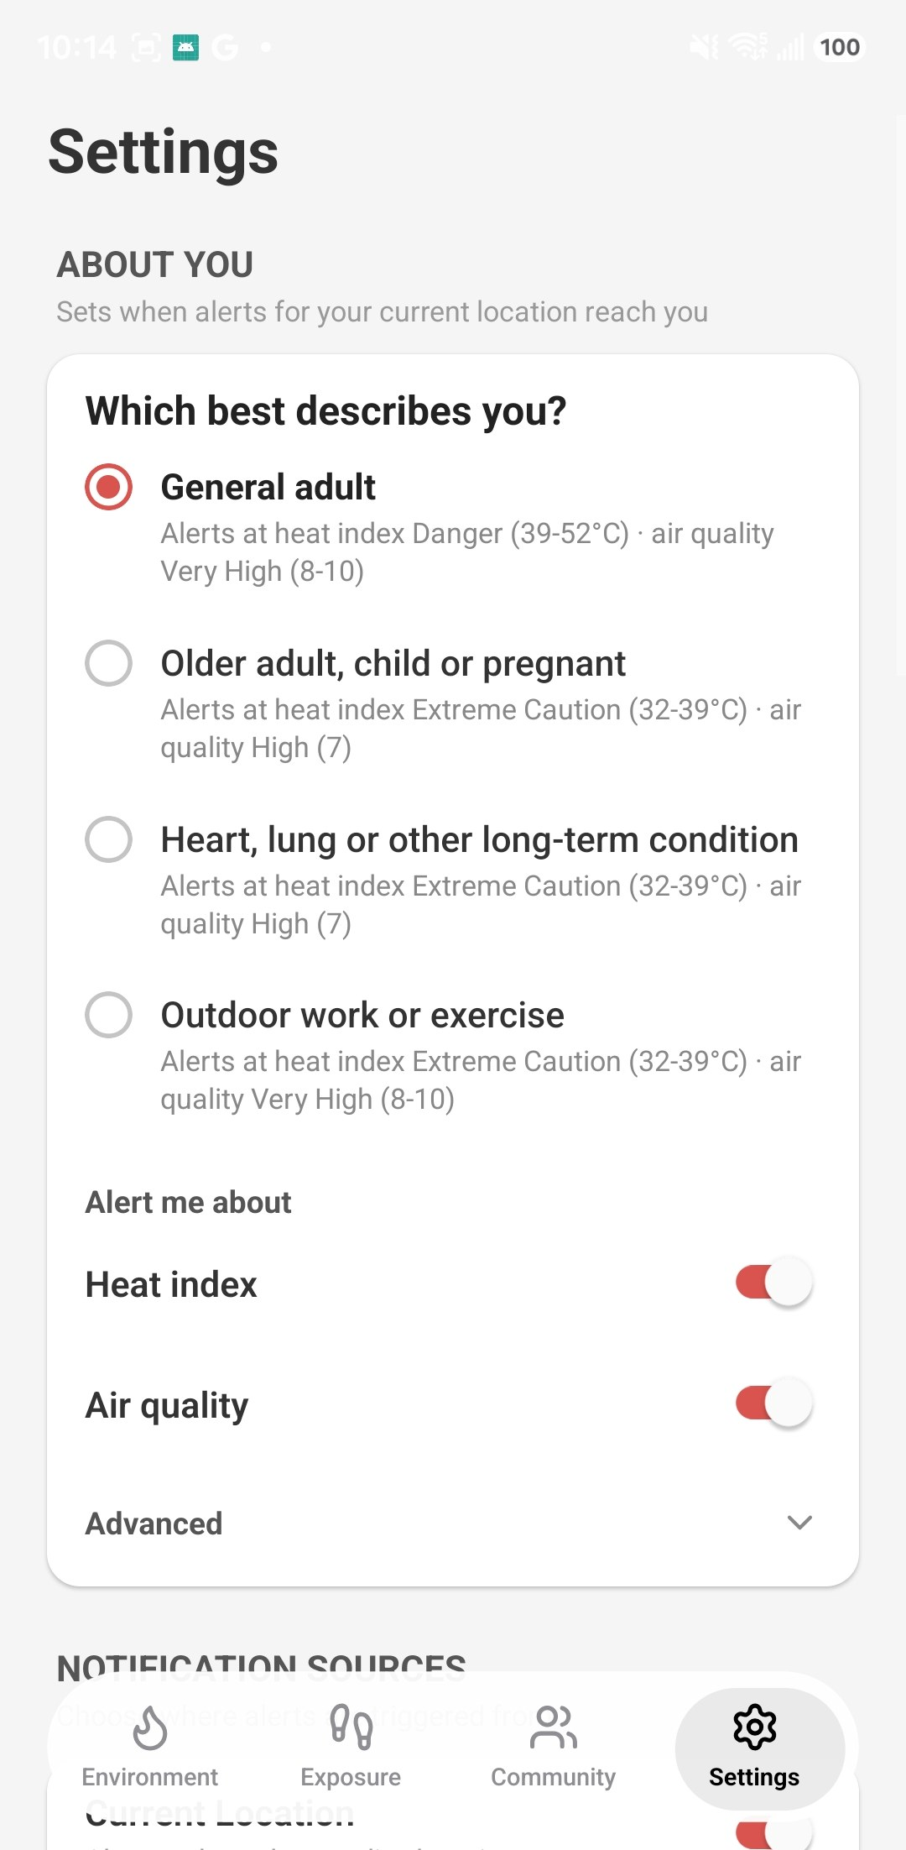
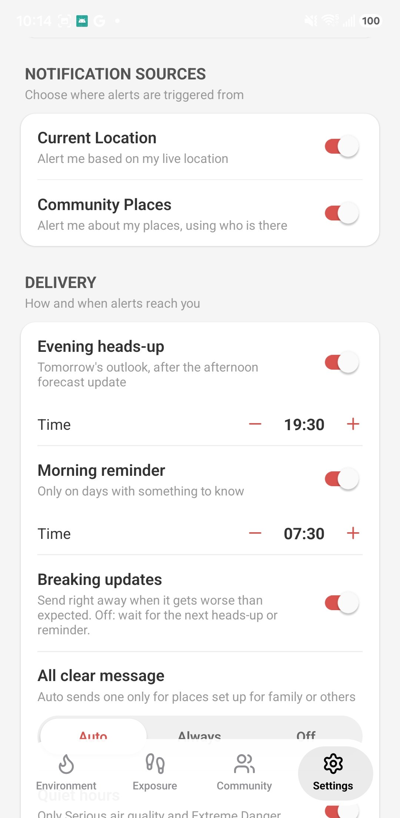
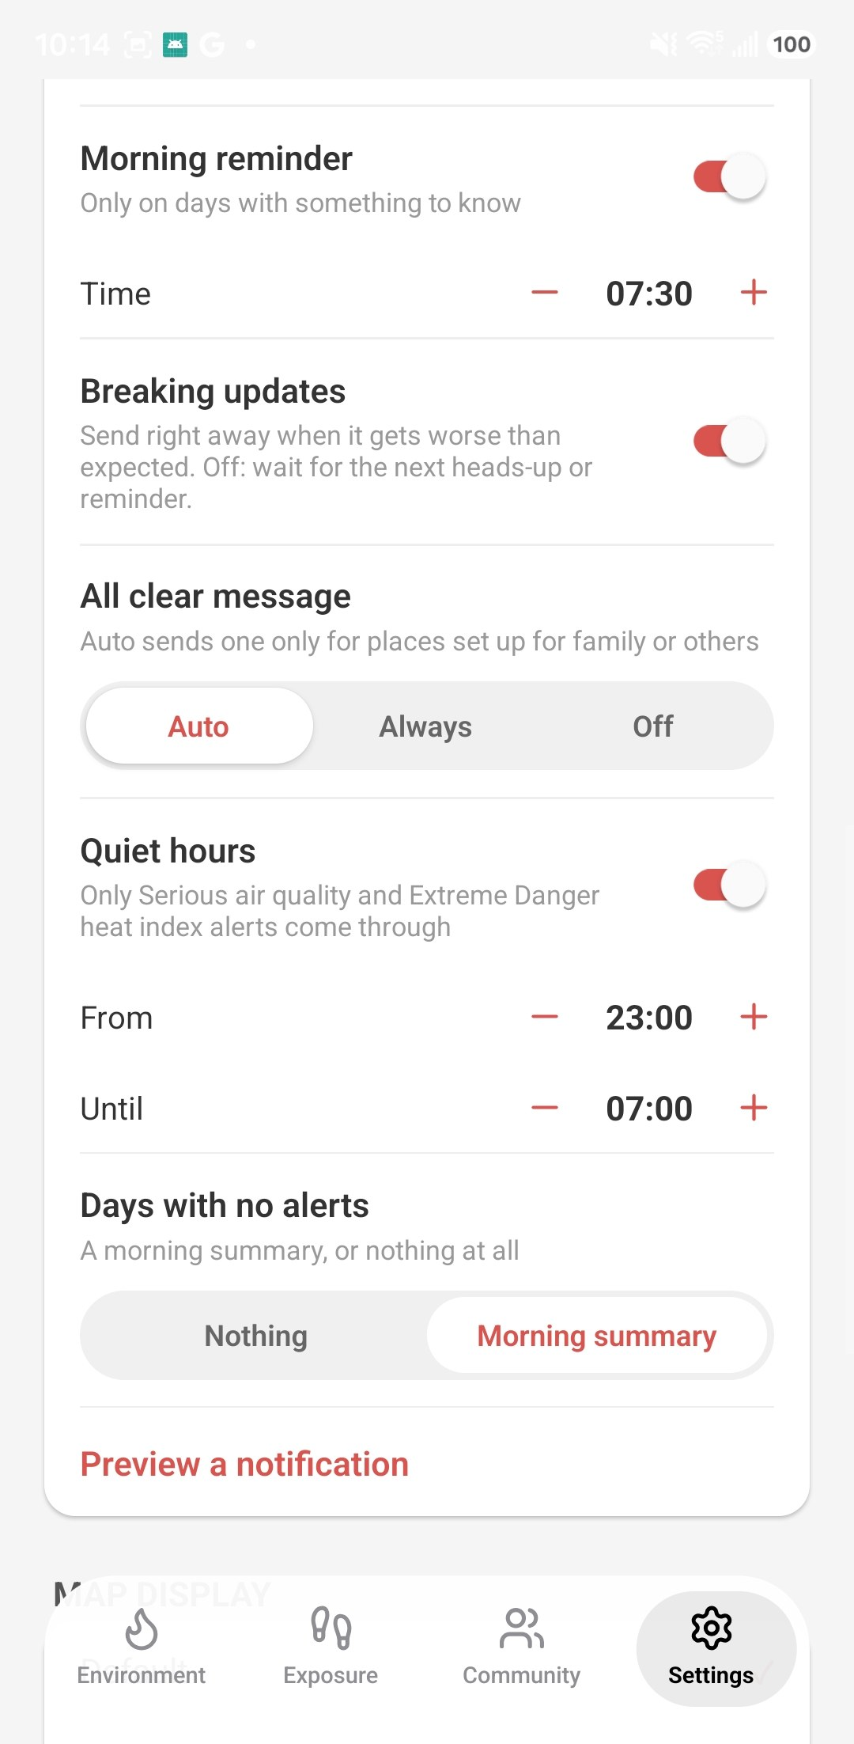
Alerts that fit you
D1 · Alerts & settings
Set who you are, where alerts come from, and when
1
Two sources
Live location + saved places
2
Scheduled
19:30 heads-up, 07:30 reminder
3
Quiet hours
Only the most serious get through
About you
Sources & timing
Quiet hours
Notes:
SettingsScreen. 'About you' = the alert profile for the current location (same 4 audiences as places). Breaking updates: send immediately when it gets worse than expected; off = wait for the next heads-up/reminder.
All clear: Auto = only for places set up for family. Days with no alerts: nothing, or a morning summary. 'Preview a notification' shows a sample heads-up.

Slide 24

One event, a few messages
D2 · Alerts & settings
An event = one hazard at one place, from first sign to all clear
1
2
3
4
Heads-up
forecast says it’s coming (up to 36 h ahead)
Active
it’s here — skipped if already told
Worse
escalation sent right away
All clear
3 h below the level
Delivery rules
Max 3 a day
Wait 10 min to combine
3 h between updates
Quiet 23:00–07:00
Heat + AQHI → one message
Urgent (Extreme Danger heat, Serious AQHI) skips every rule.
Notes:
State machine in src/utils/alertEvents.ts: forecast → active → easing → cleared (or cancelled). A return within 6 h continues the same event instead of a new one.
Delivery (src/utils/alertDelivery.ts): daily cap 3 non-urgent, 10-min batching window, 3-h per-event cooldown, quiet hours. Over the cap, notices wait — not dropped.
Messages (src/utils/alertMessages.ts): many places → one message; heat + AQHI together → 'double risk' advice (stay indoors with AC, windows closed).
Heat heads-ups are off until the heat API has a real forecast.

Slide 25



Logic: alert check pipeline
D3 · Alerts & settings
Runs every 5 min in the app, and in the background
Readings
now + hourly forecast per place
Signals
first window at/above the level
Events
update each event’s state
Delivery
quiet hours, cap, cooldown
Message
merge places & hazards
Notify
push + saved for detail
App open: every 5 min
Background fetch
Timer for 07:30 / 19:30
Steps 2–5 are pure functions with unit tests
Notes:
runAlertCheck (src/services/alertCheckService.ts):
1 alertReadings.ts 2 utils/alertSignals.ts 3 utils/alertEvents.ts (state in AsyncStorage) 4 utils/alertDelivery.ts 5 utils/alertMessages.ts 6 notificationService.ts (Notifee, normal + urgent channels).
Triggers: AlertEngine component (5-min foreground timer), backgroundAlertService (react-native-background-fetch periodic + one-shot digest timer). Tapping a notification opens AlertDetailSheet.

Slide 26
In one line each
Environment See heat and air quality now, next 3 days, on a map
Exposure Turn your GPS day into personal exposure by place type
Community places Save the places that matter and who is there
Alerts & settings Get a few right-sized alerts per episode
Next
Official HKO warnings
Real heat forecast
Server push
Notes:
Not built yet (from CLAUDE.md): official HKO / Labour Department warnings, heat heads-ups (need a real API forecast), server push. Open questions in the notification design doc: heat forecast source, sensitive-group thresholds need expert review, health data privacy.

